Slide 1
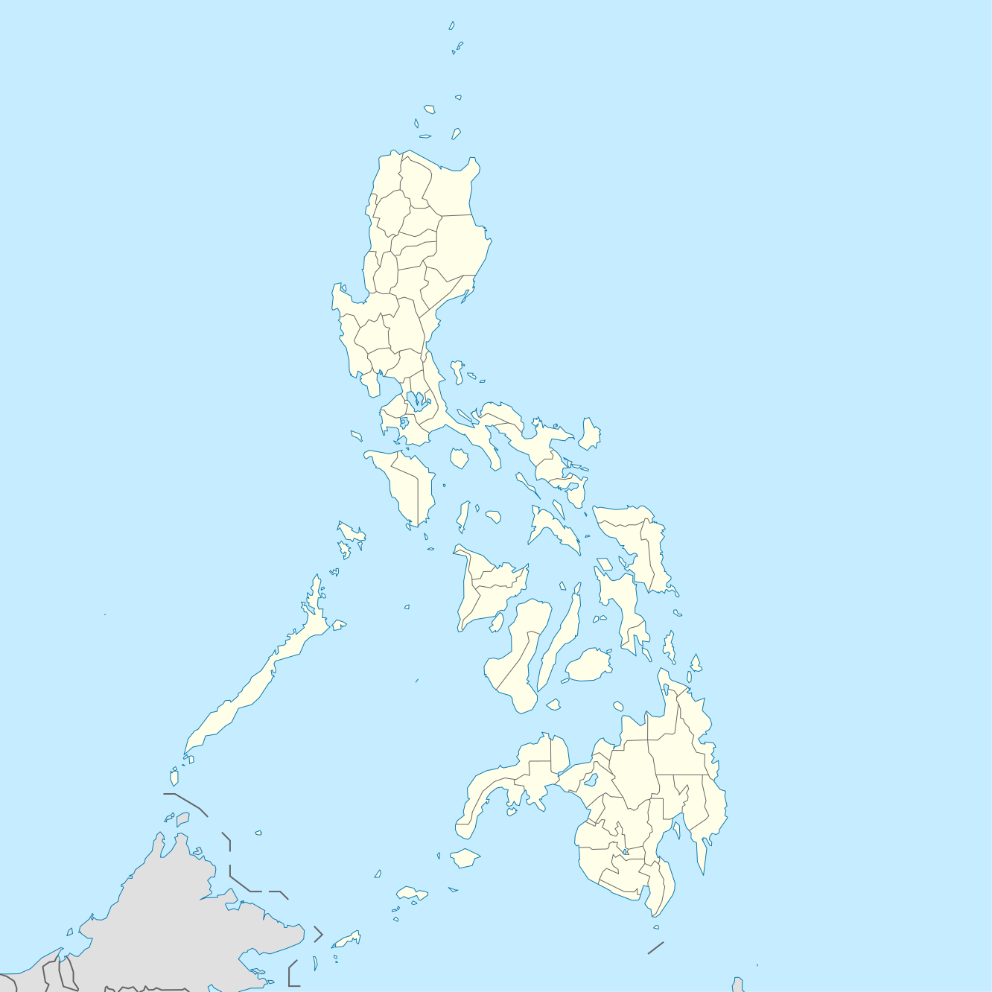
ano kaya ang sa tuktok ng Pilipinas?

Slide 2
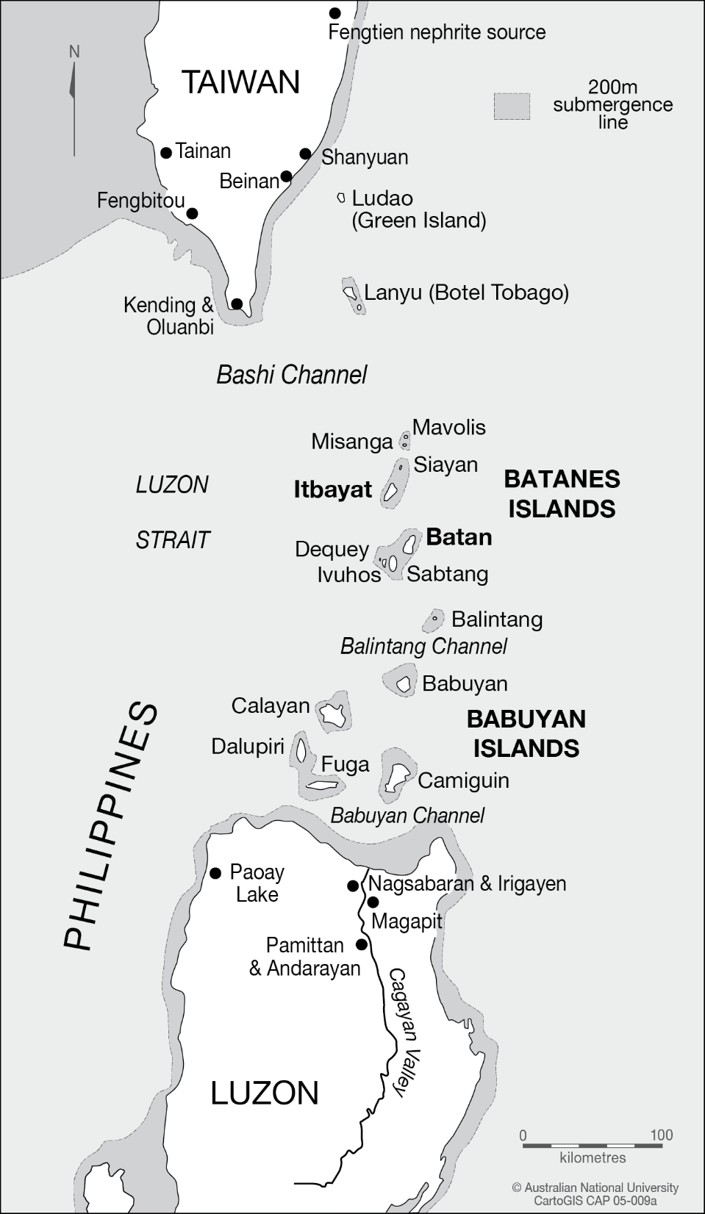
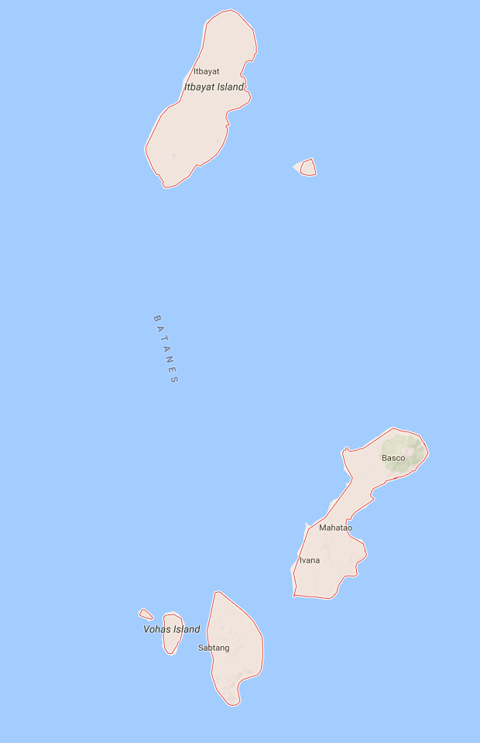
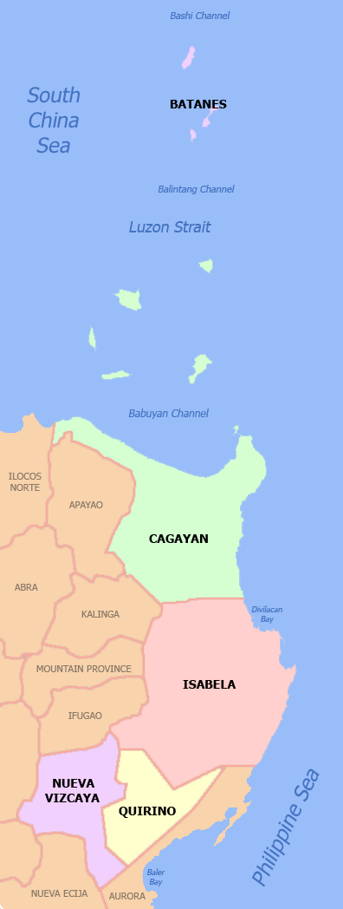
Paglalarawan slides 2-8

Slide 3
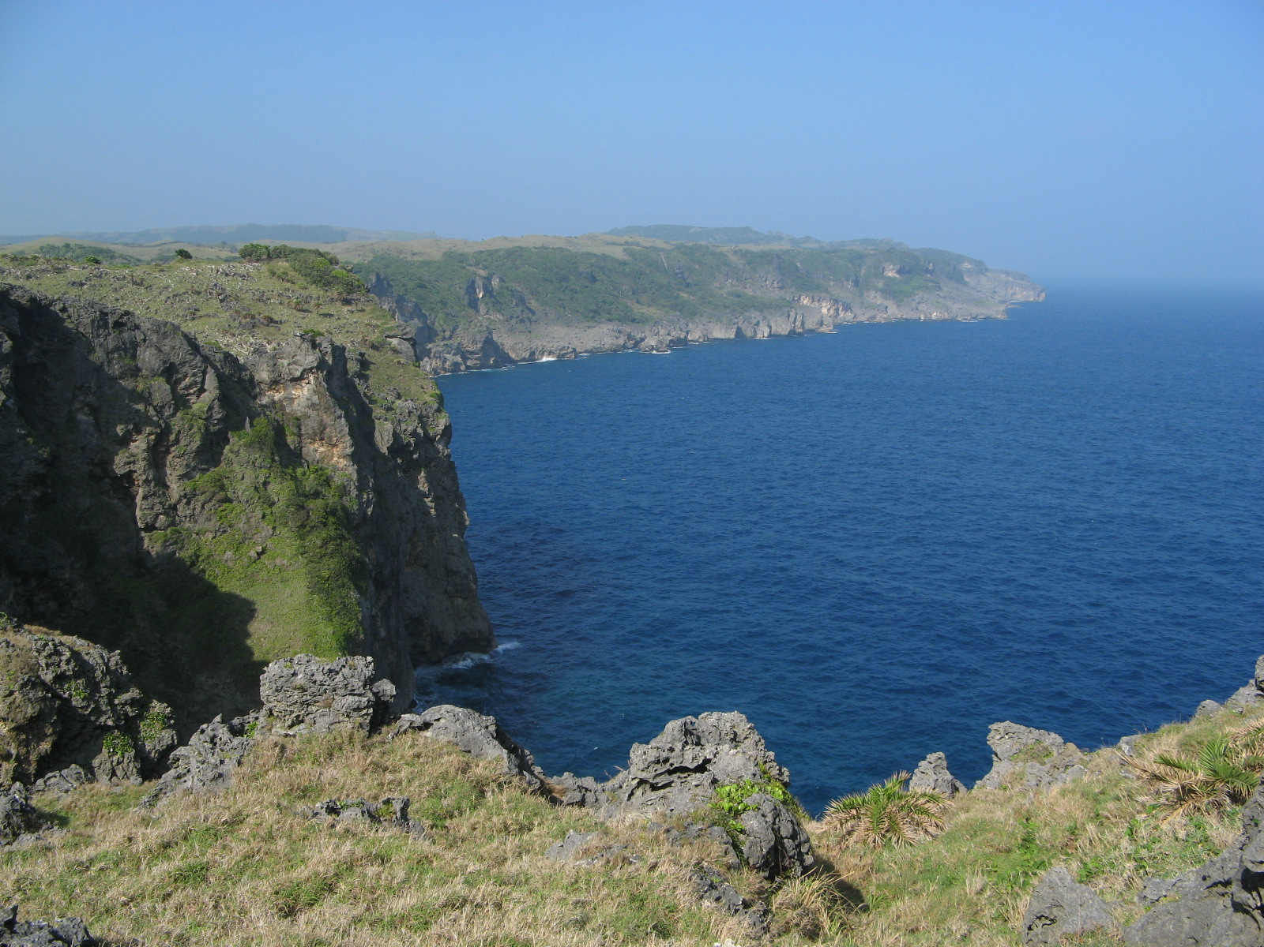

Slide 4
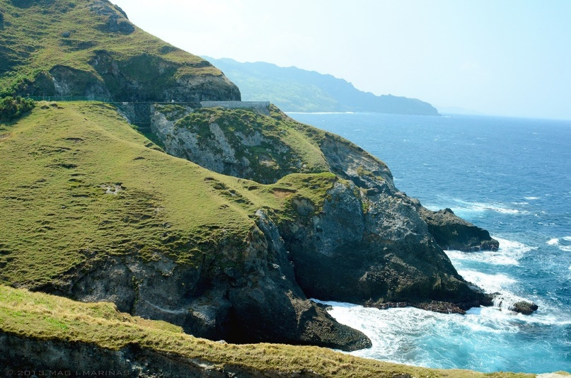

Slide 5
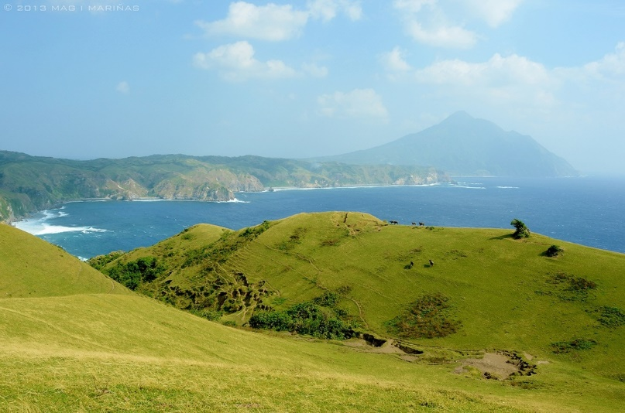

Slide 6
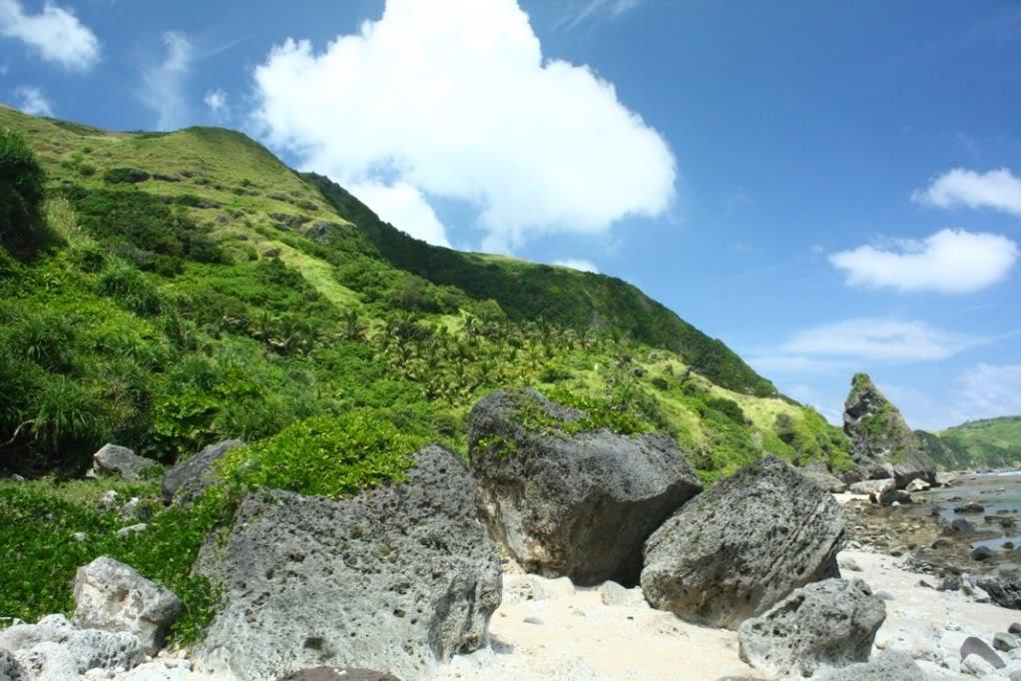

Slide 7
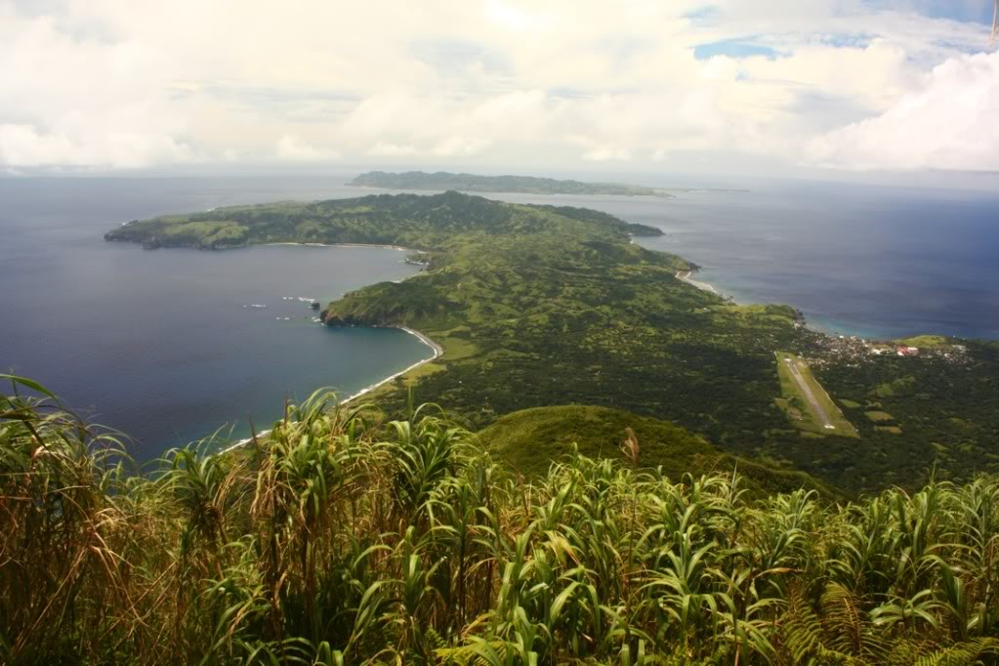

Slide 9
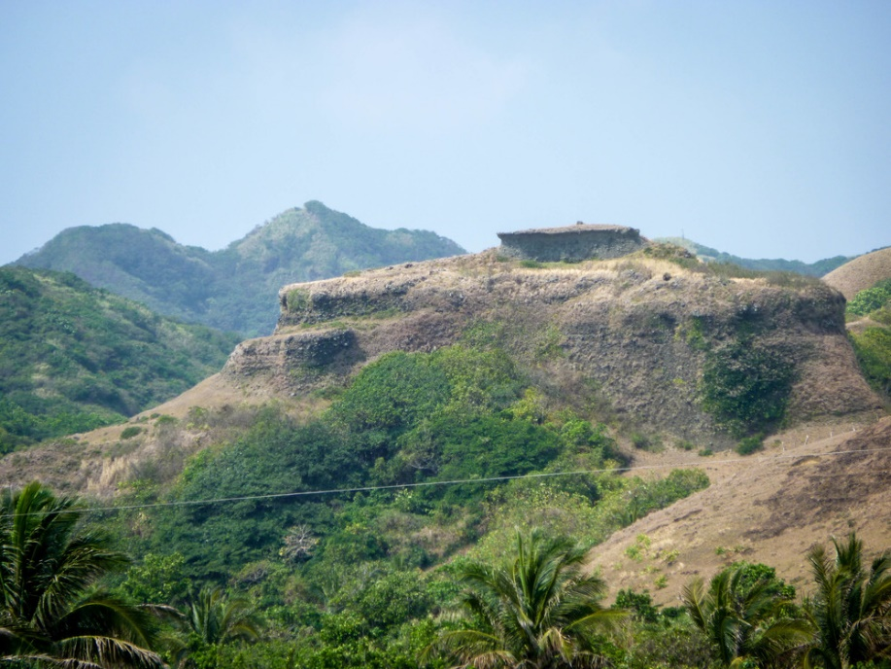
sabtang idjang!
Salaysay slides 9-12

Slide 10
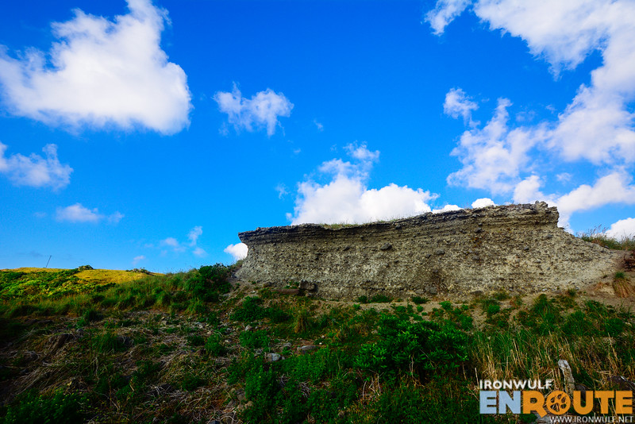

Slide 11
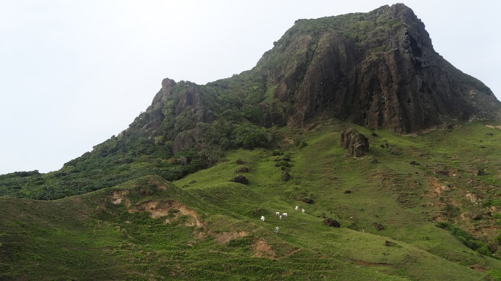
siayan idjang!

Slide 12
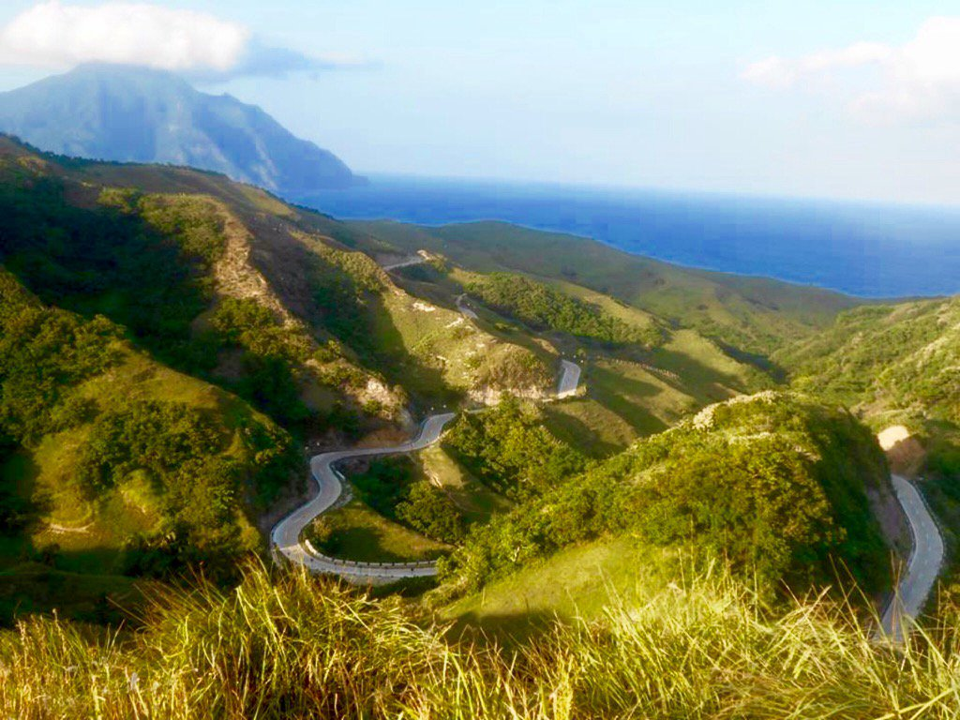
nakavahayan idjang!

Slide 13
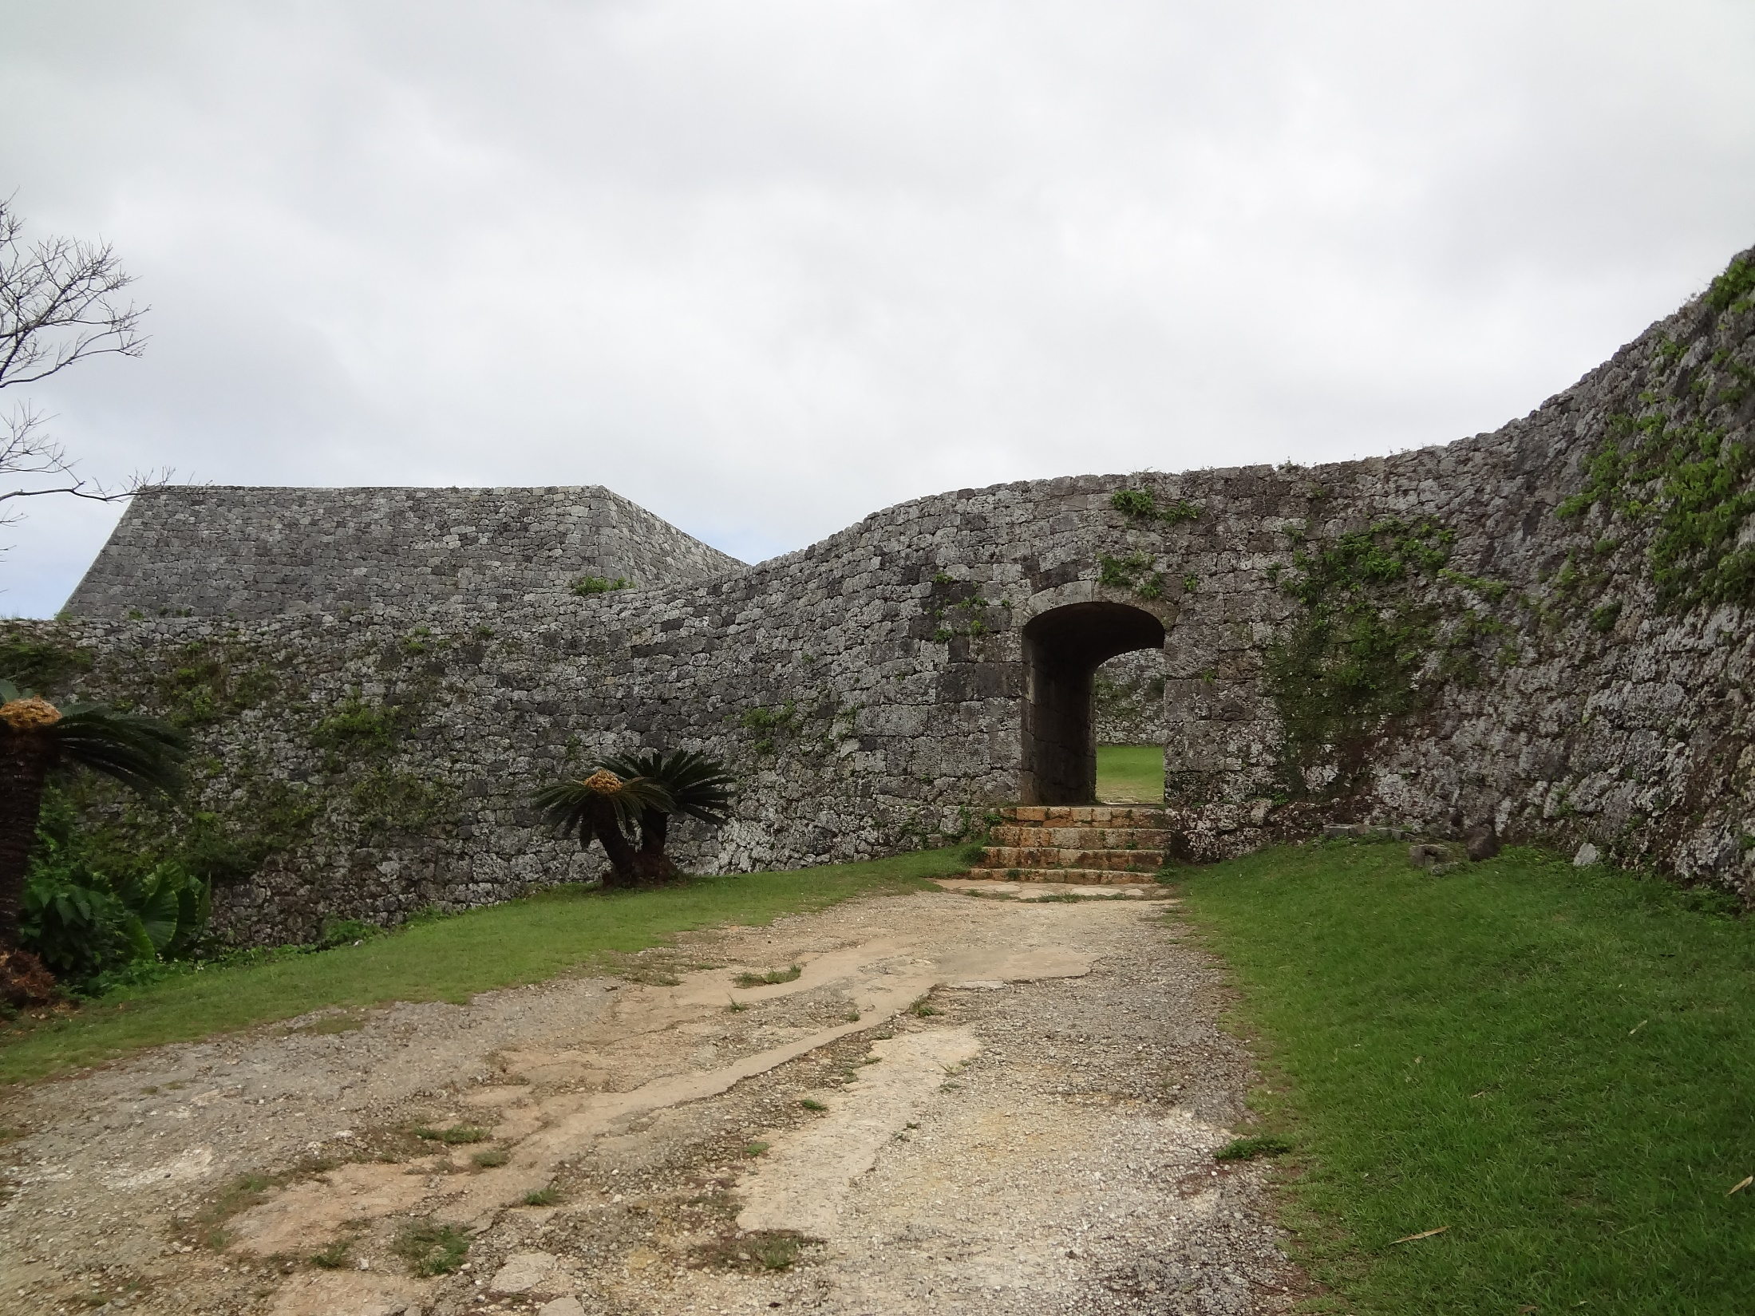
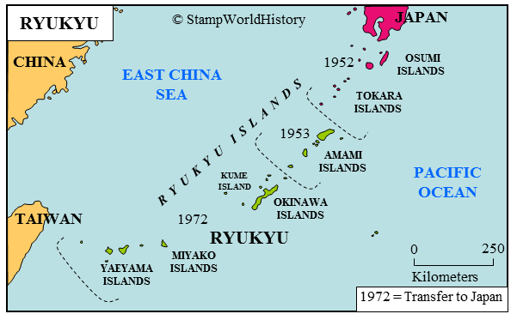
gusuku

Slide 14
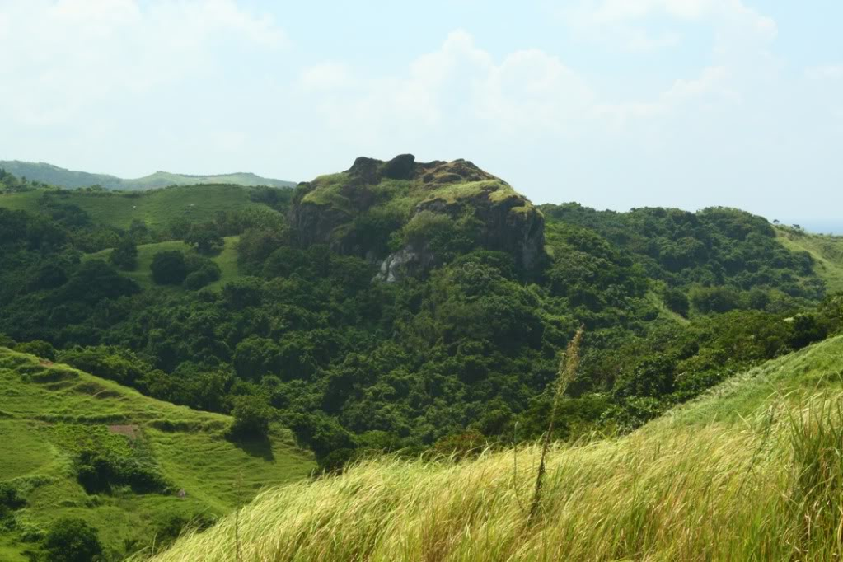

Slide 15
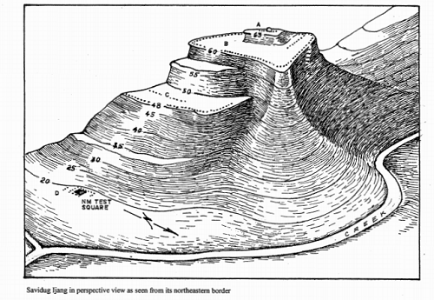
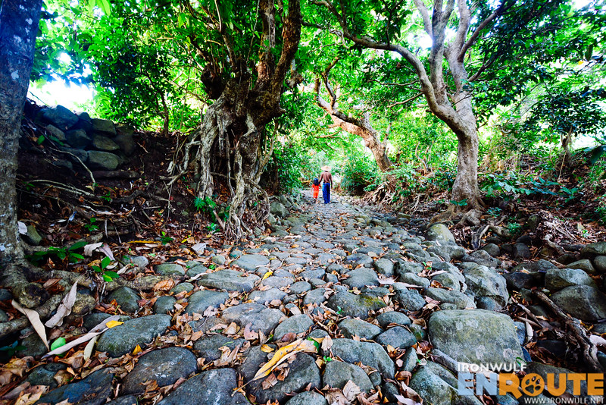

Slide 16
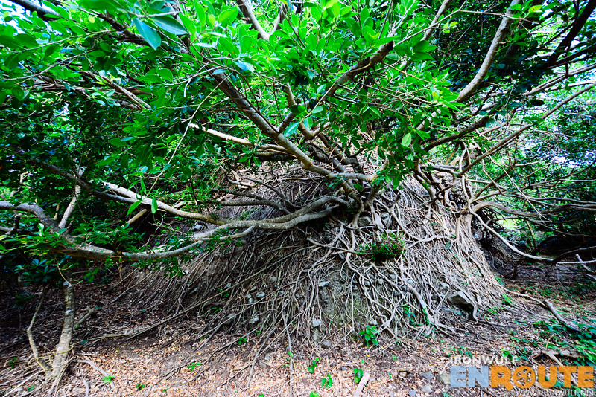

Slide 17
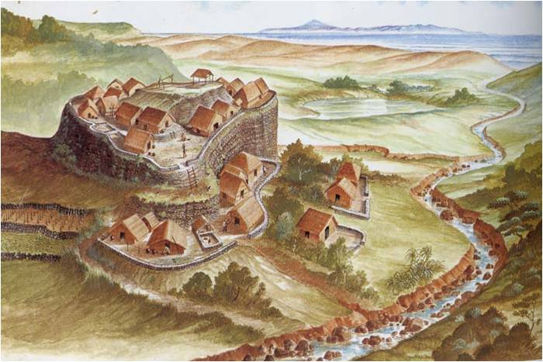
~3200 years of occupation at Savidug

Slide 18
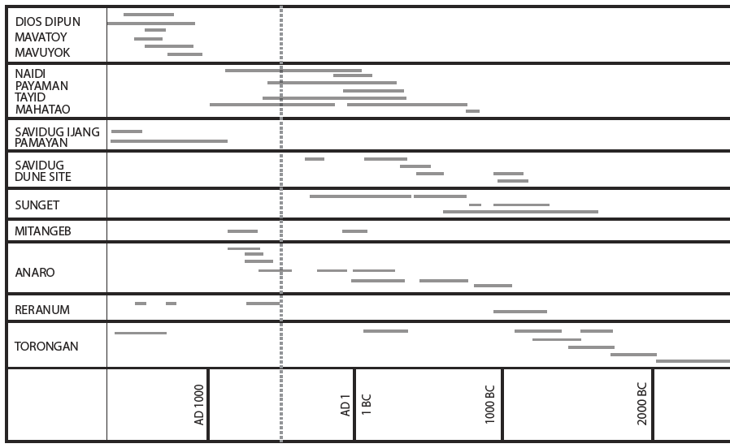

Slide 19
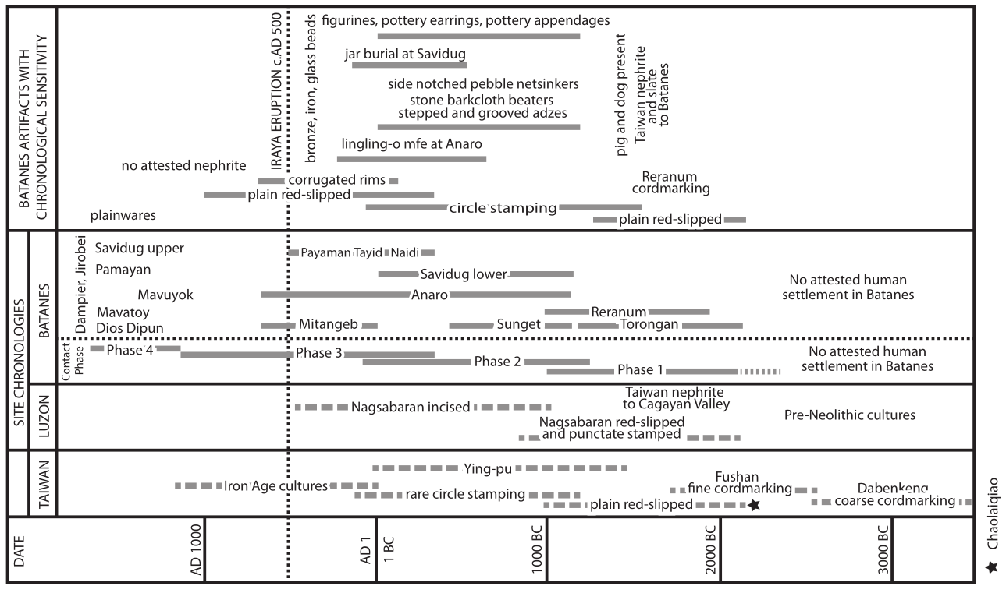

Slide 20
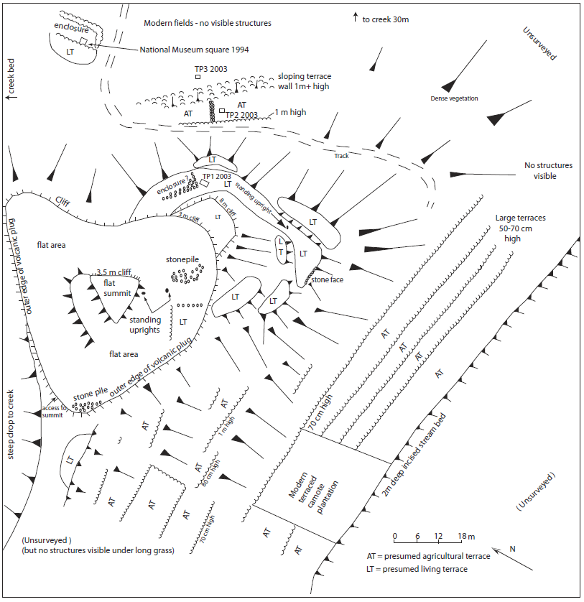

Slide 21
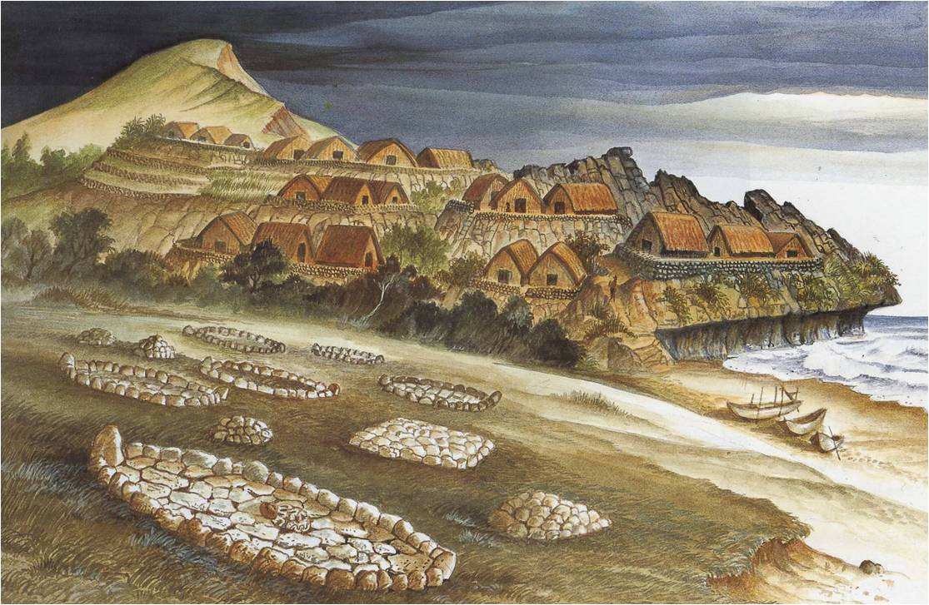

Slide 22
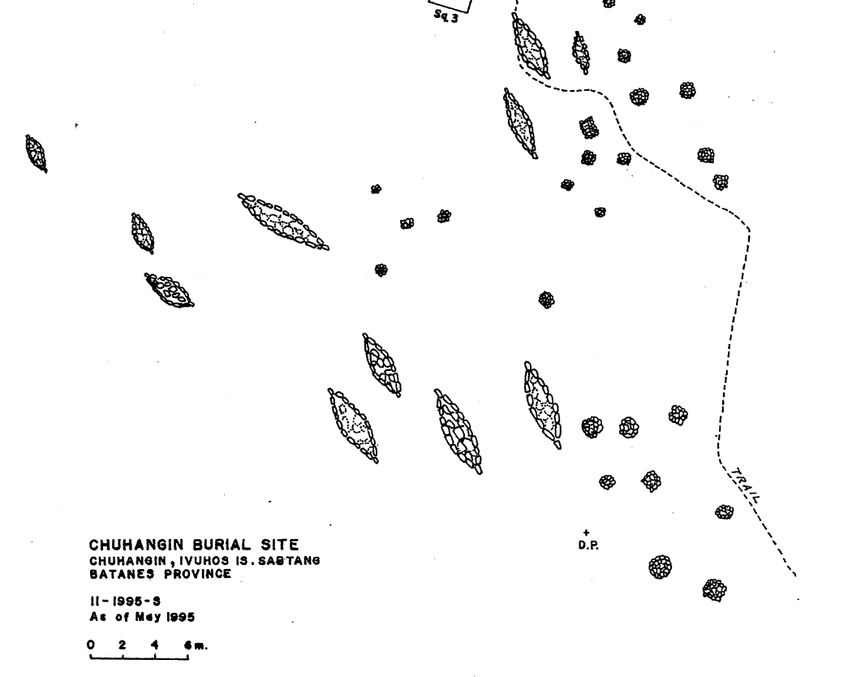

Slide 23
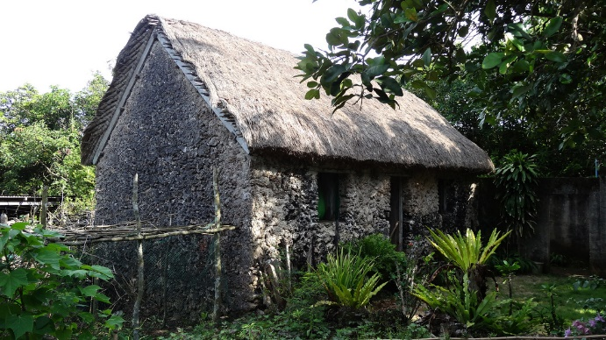

Slide 24
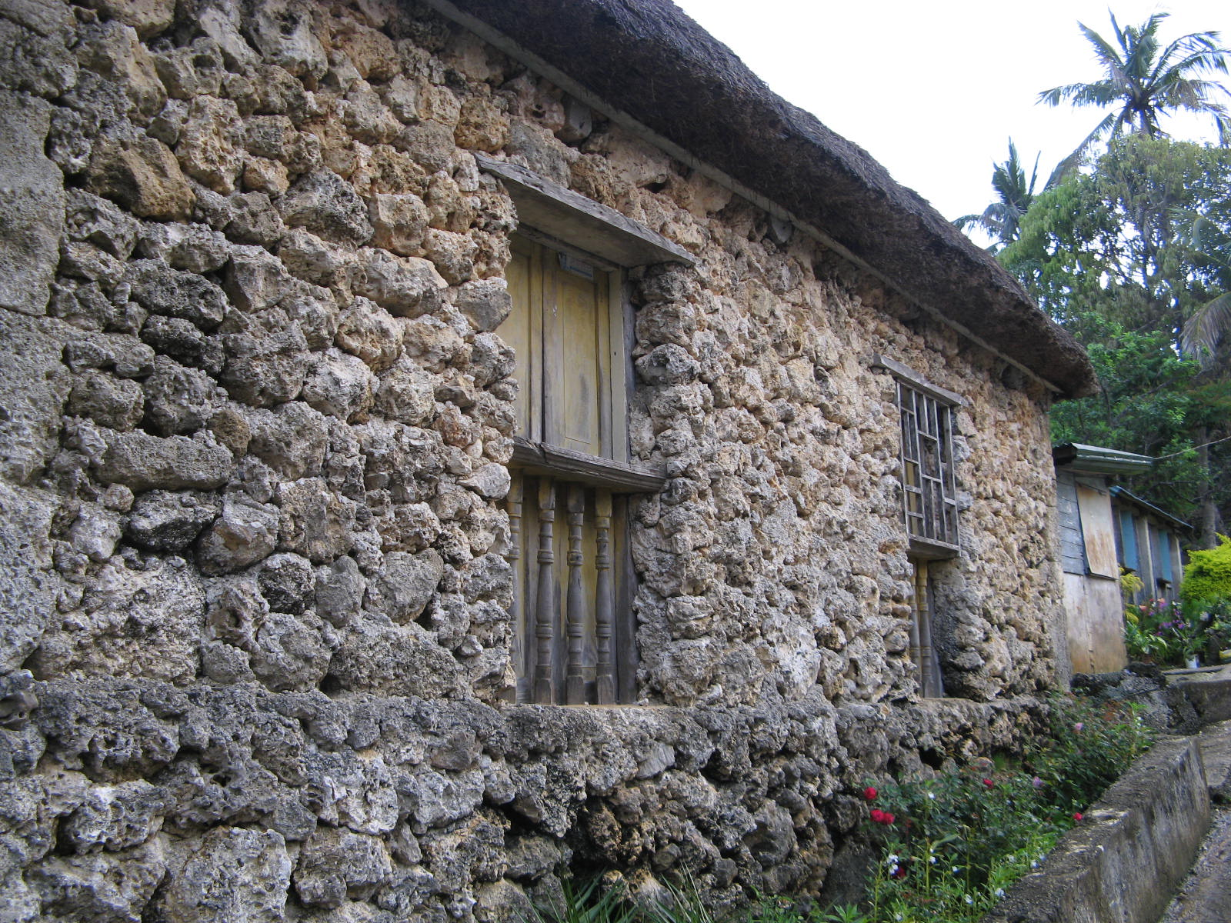
2-3ft makapal na dingding

Slide 25
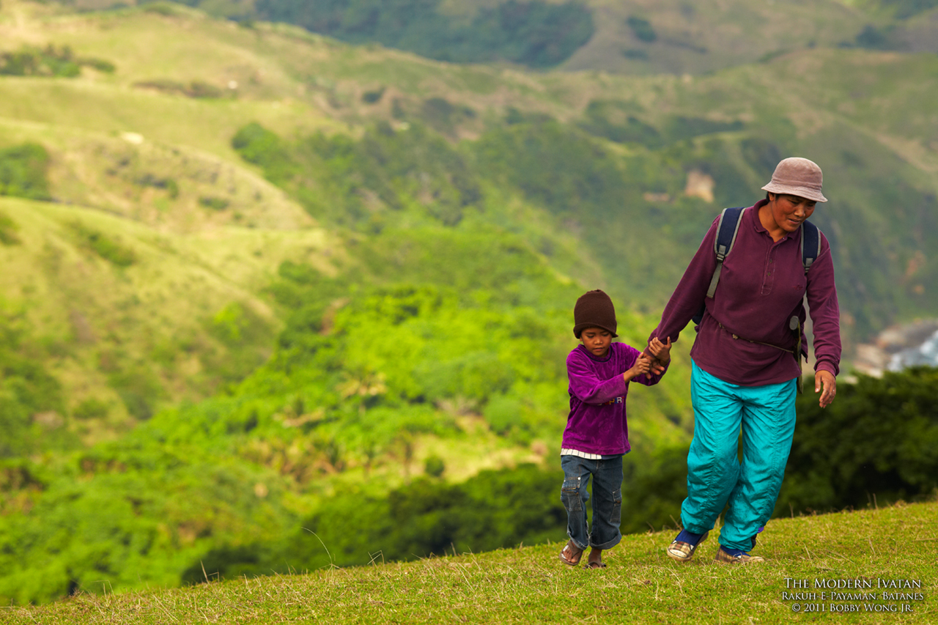

Slide 26
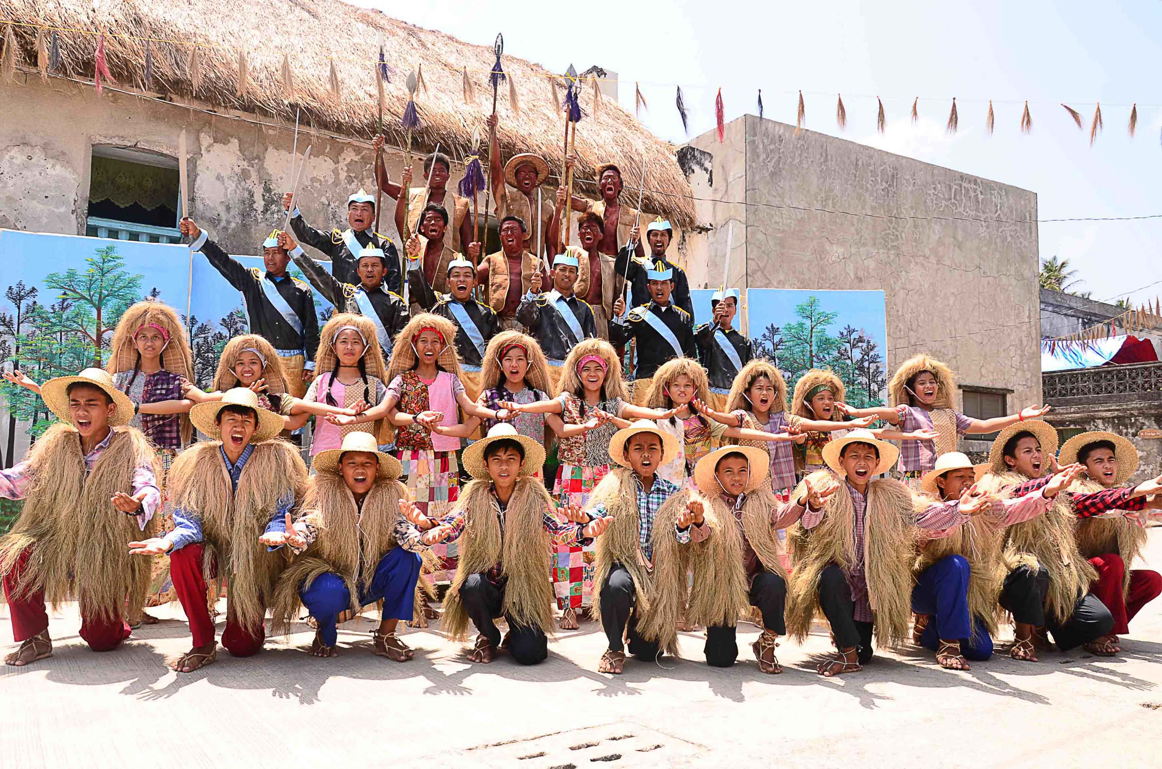
Kasalukuyang Pangyayari - Vakul-Kanayi Festival

Slide 27
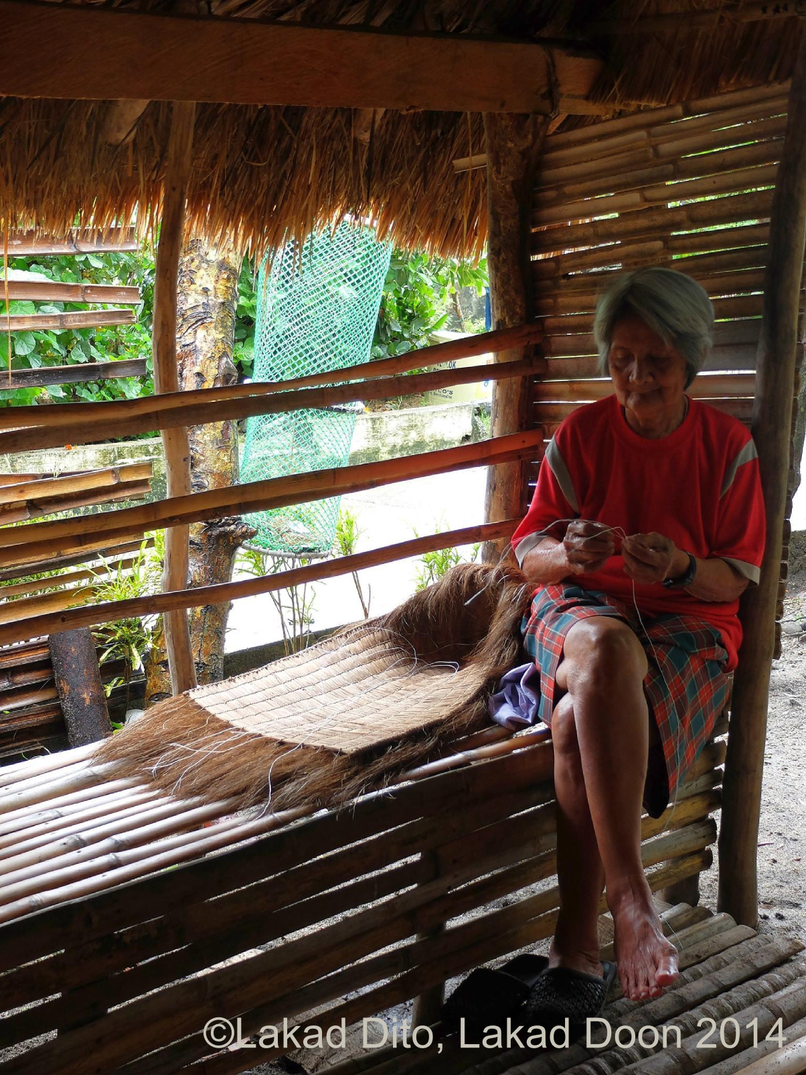

vakul (pangbabae)
(ginawa sa isang lingo)

Slide 28
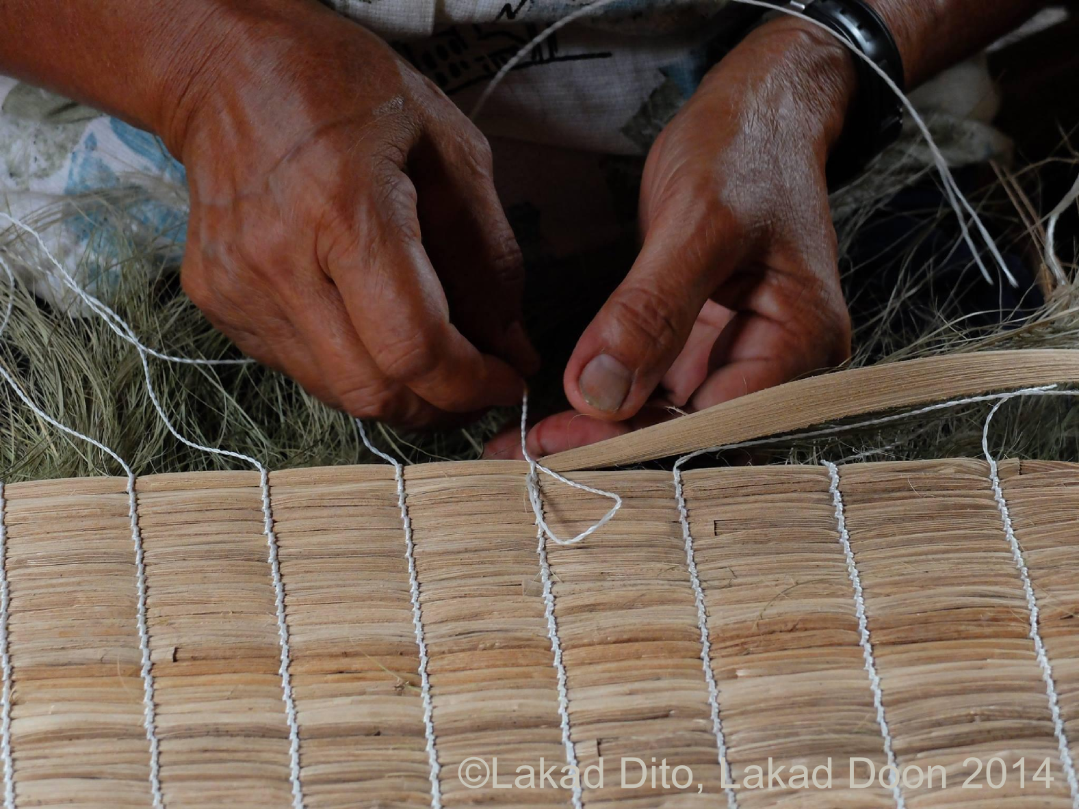

Slide 29
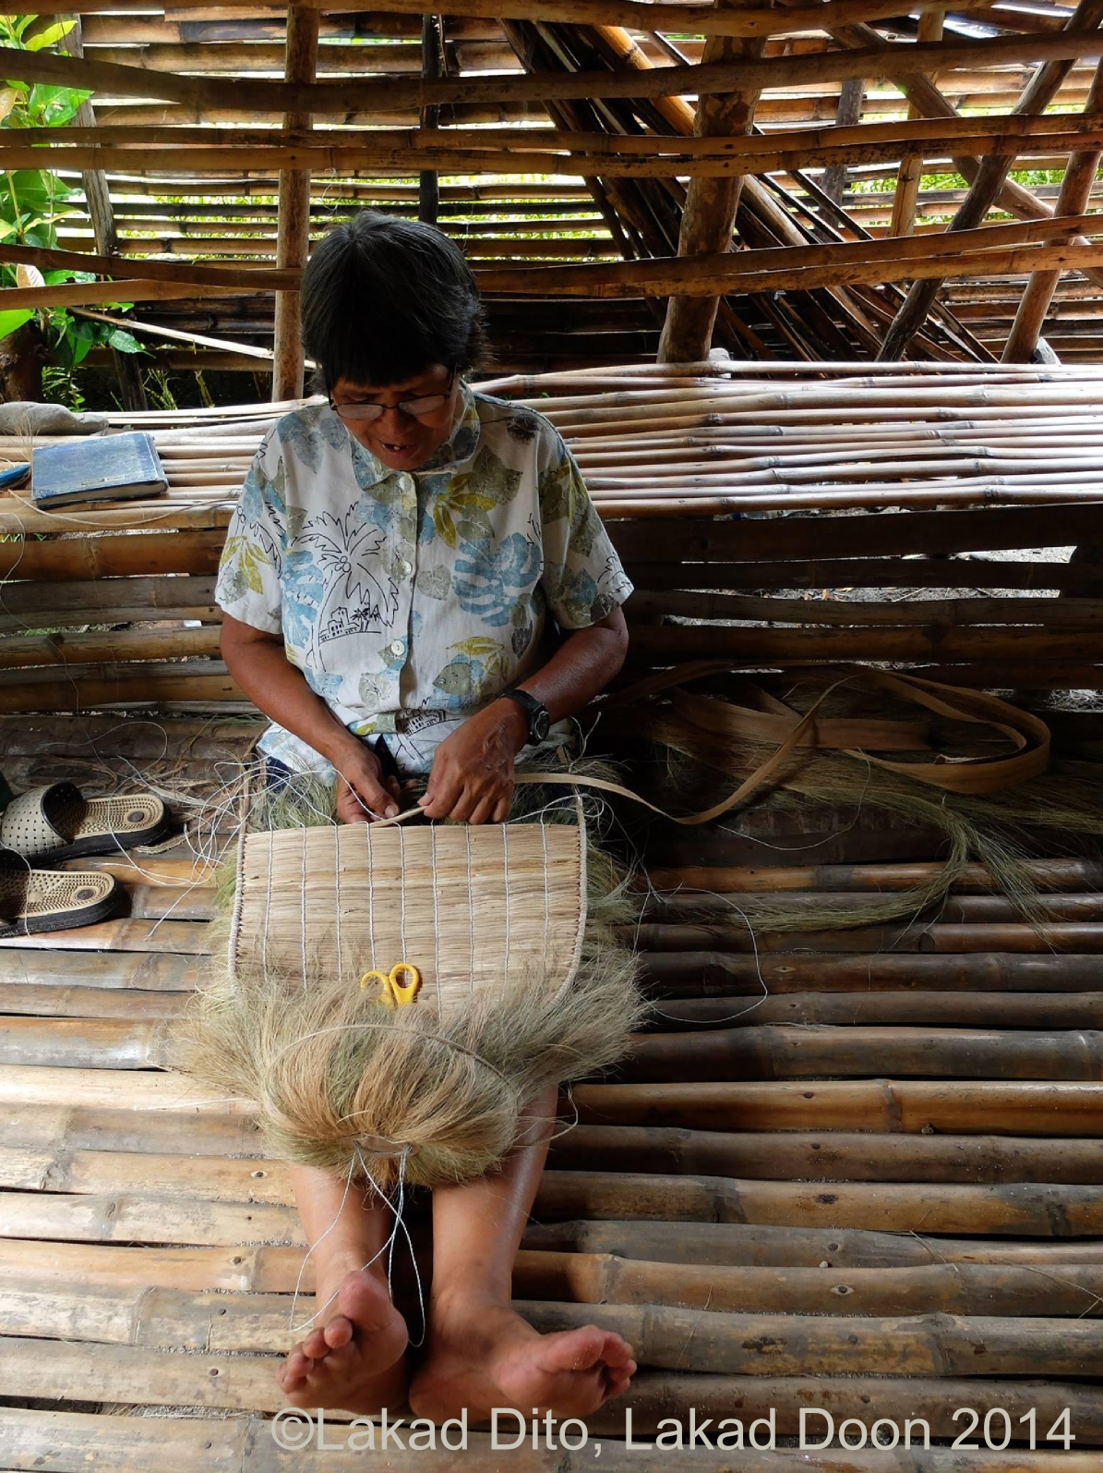

Slide 30
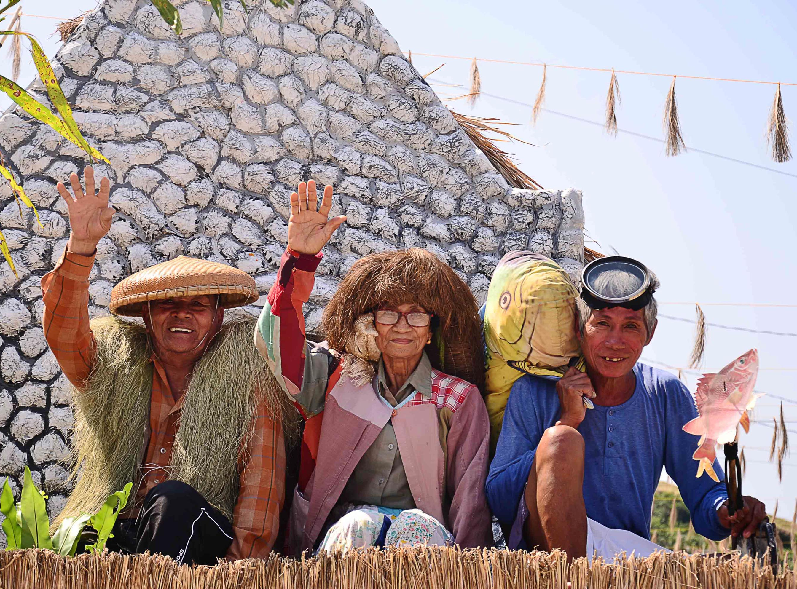
kanayi (panglalaki)

Slide 31
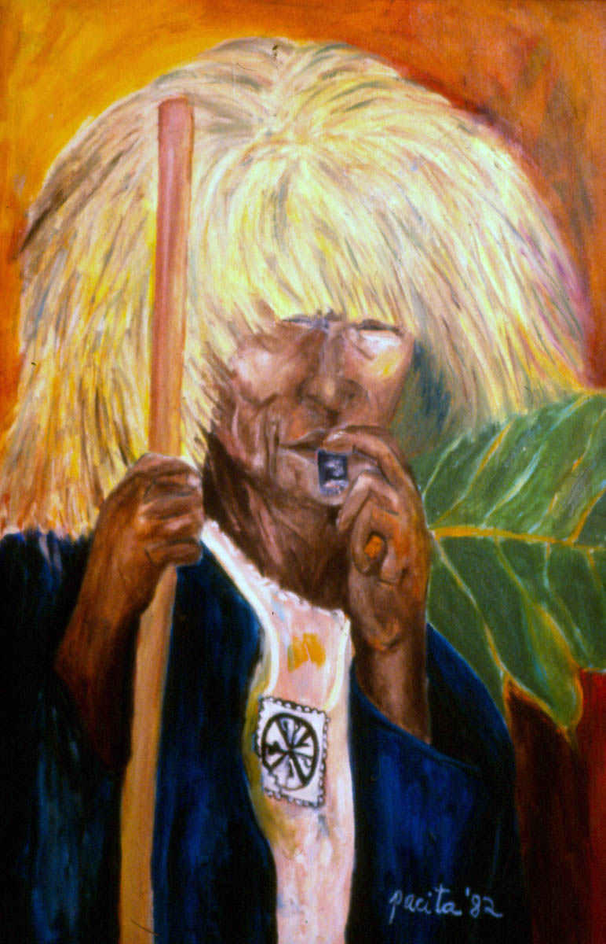
Pacita Abad

Slide 32

ipinanganak sa Batanes

Slide 33


Slide 34
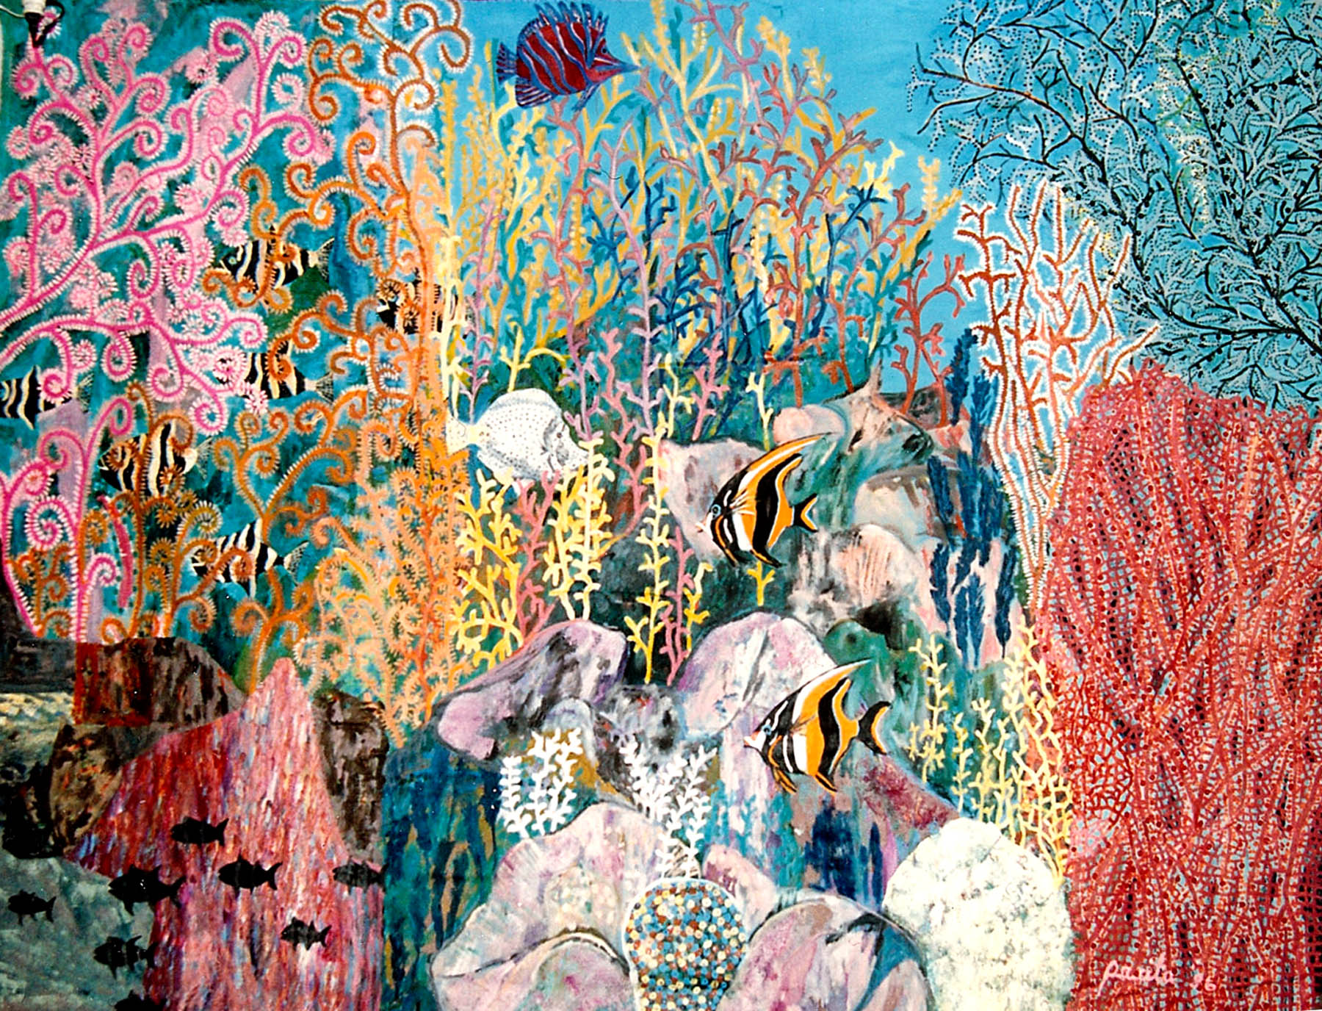

Slide 35


Slide 36


Slide 37
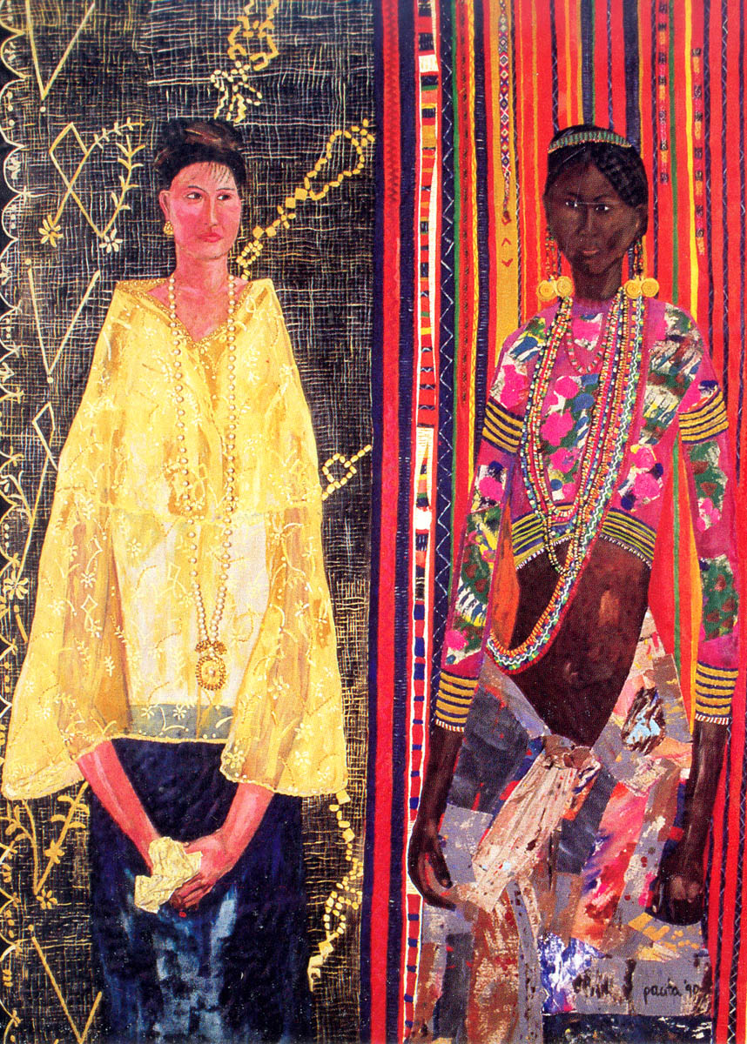

Slide 38
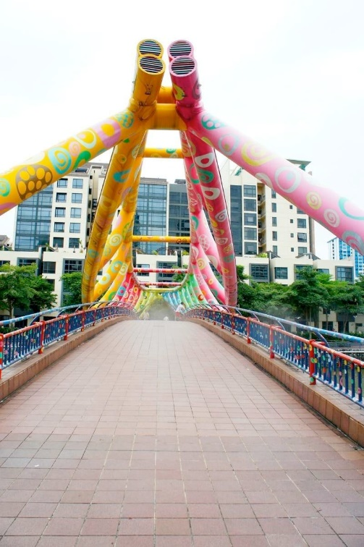
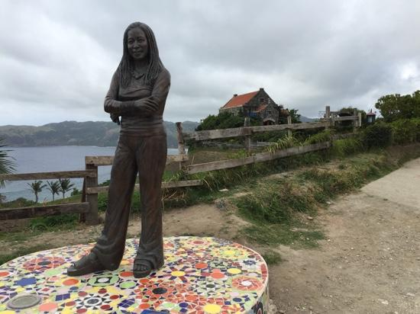
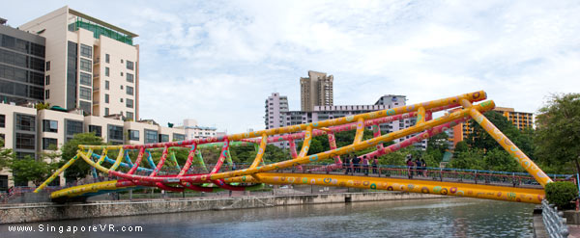

Slide 39


Slide 40
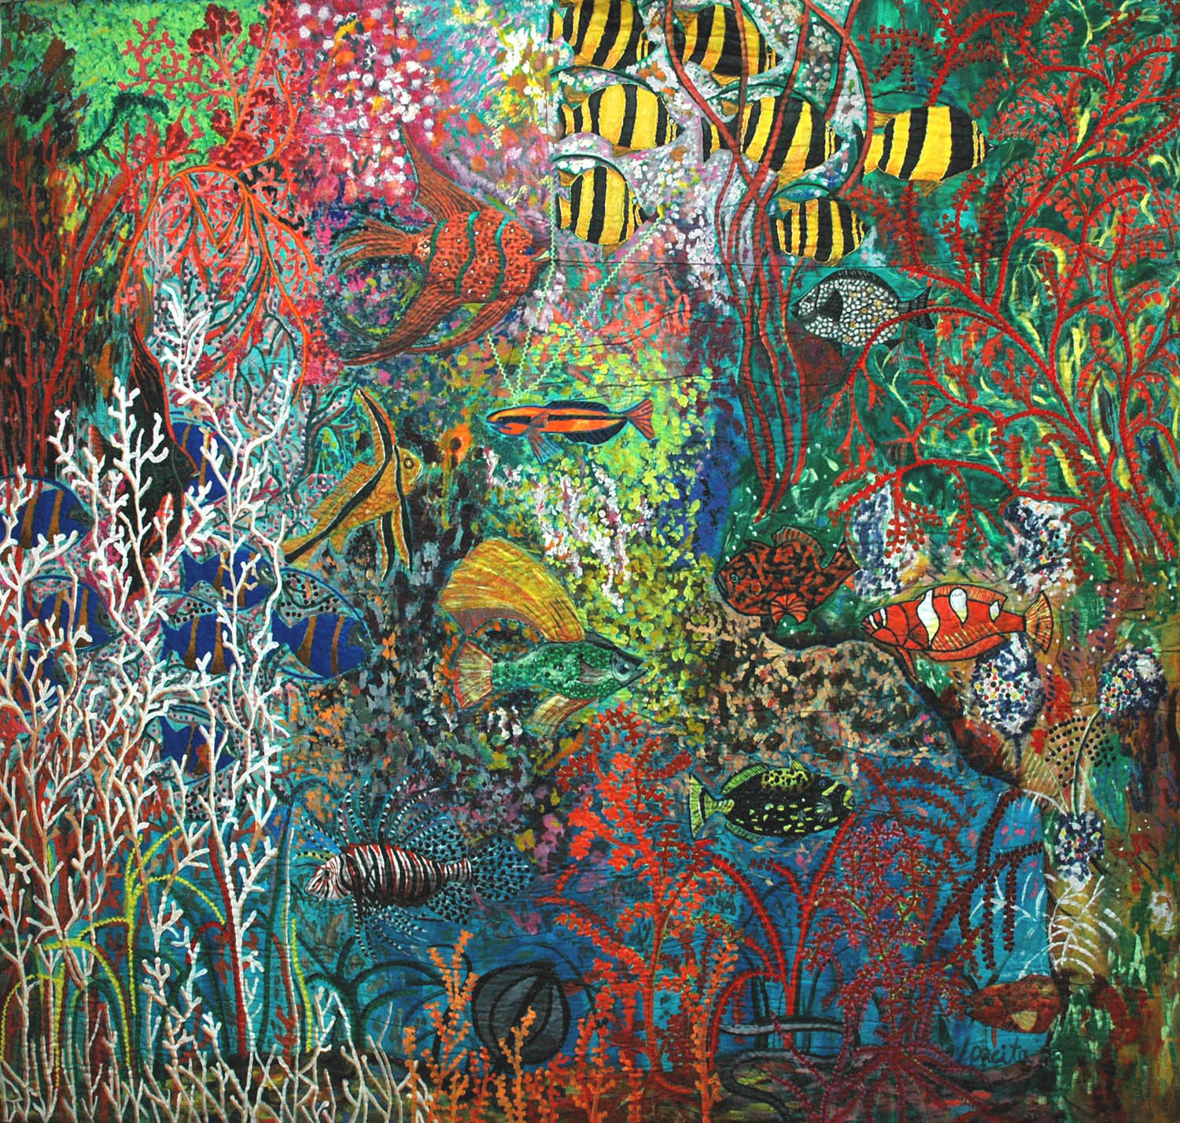

Slide 41
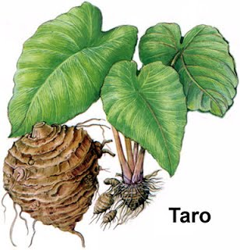
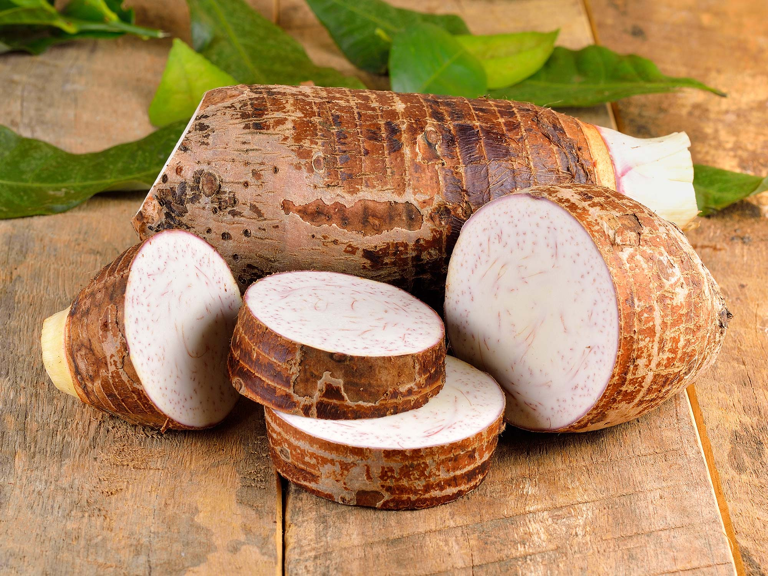
pagkain

Slide 42
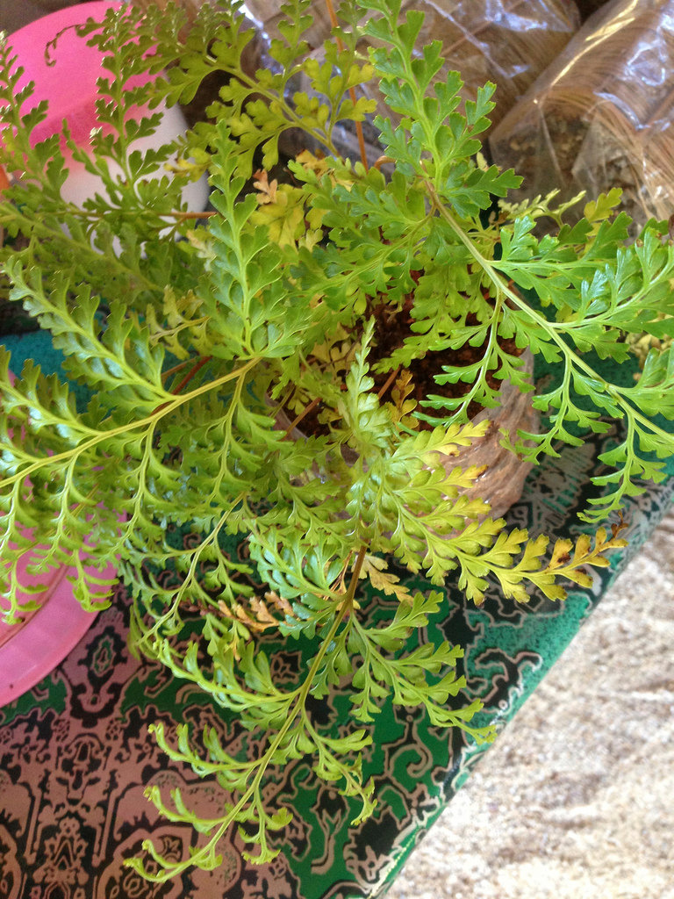
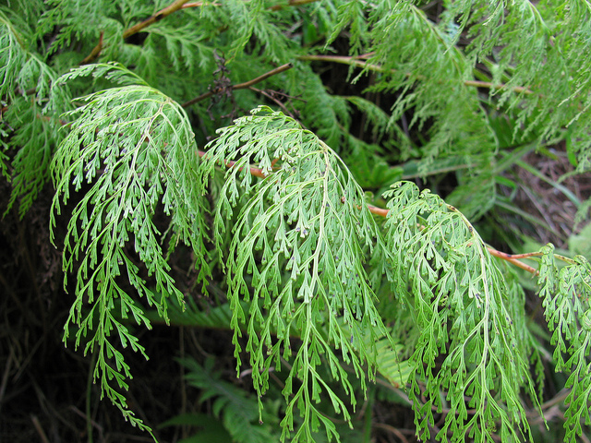
Tubho Tea (herbal)
Terrestrial, along roadsides, forest margins; 300-1700 m. China, Taiwan, Xizang, Yunnan, Bangladesh, Bhutan, India, Japan, Korea, Malaysia, Myanmar, Nepal, Philippines, Sri Lanka, Thailand, Vietnam; Madagascar, Pacific islands (including Polynesia).
Paraan slides 41-44
Lace fern / Odontosoria Chinensis

Slide 43
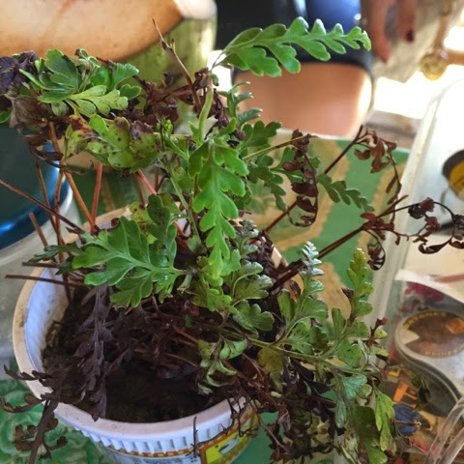
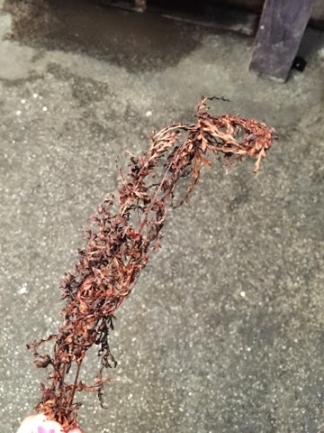
6-8 stems

Slide 44
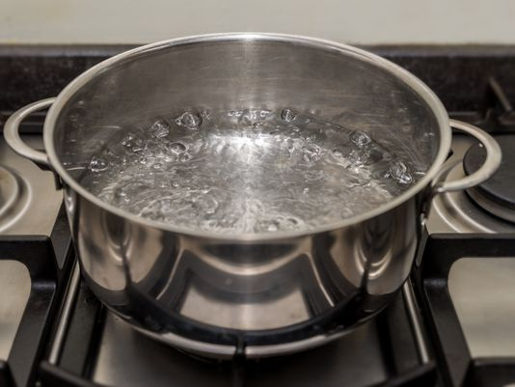
1 litre
15-20mins

Slide 45
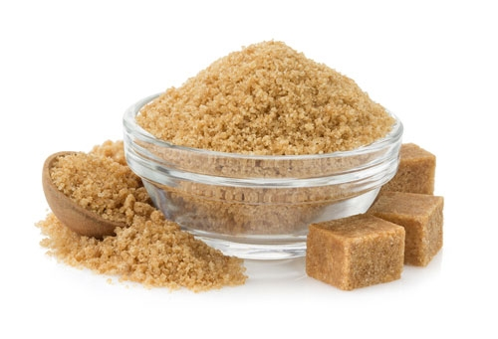
Notes:
Alisin ang mga dahon,
idugdug brown sugar
Wintermelon / Gulaman Taste

Slide 46
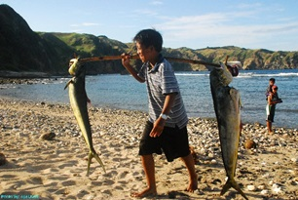
Arava u mayet an namaes u ryes.
‘There is no strong man when the sea is at its worst’.
Arava u ryes a abu su vinyedi.
‘There is no current that does not bounce back’.

Slide 47
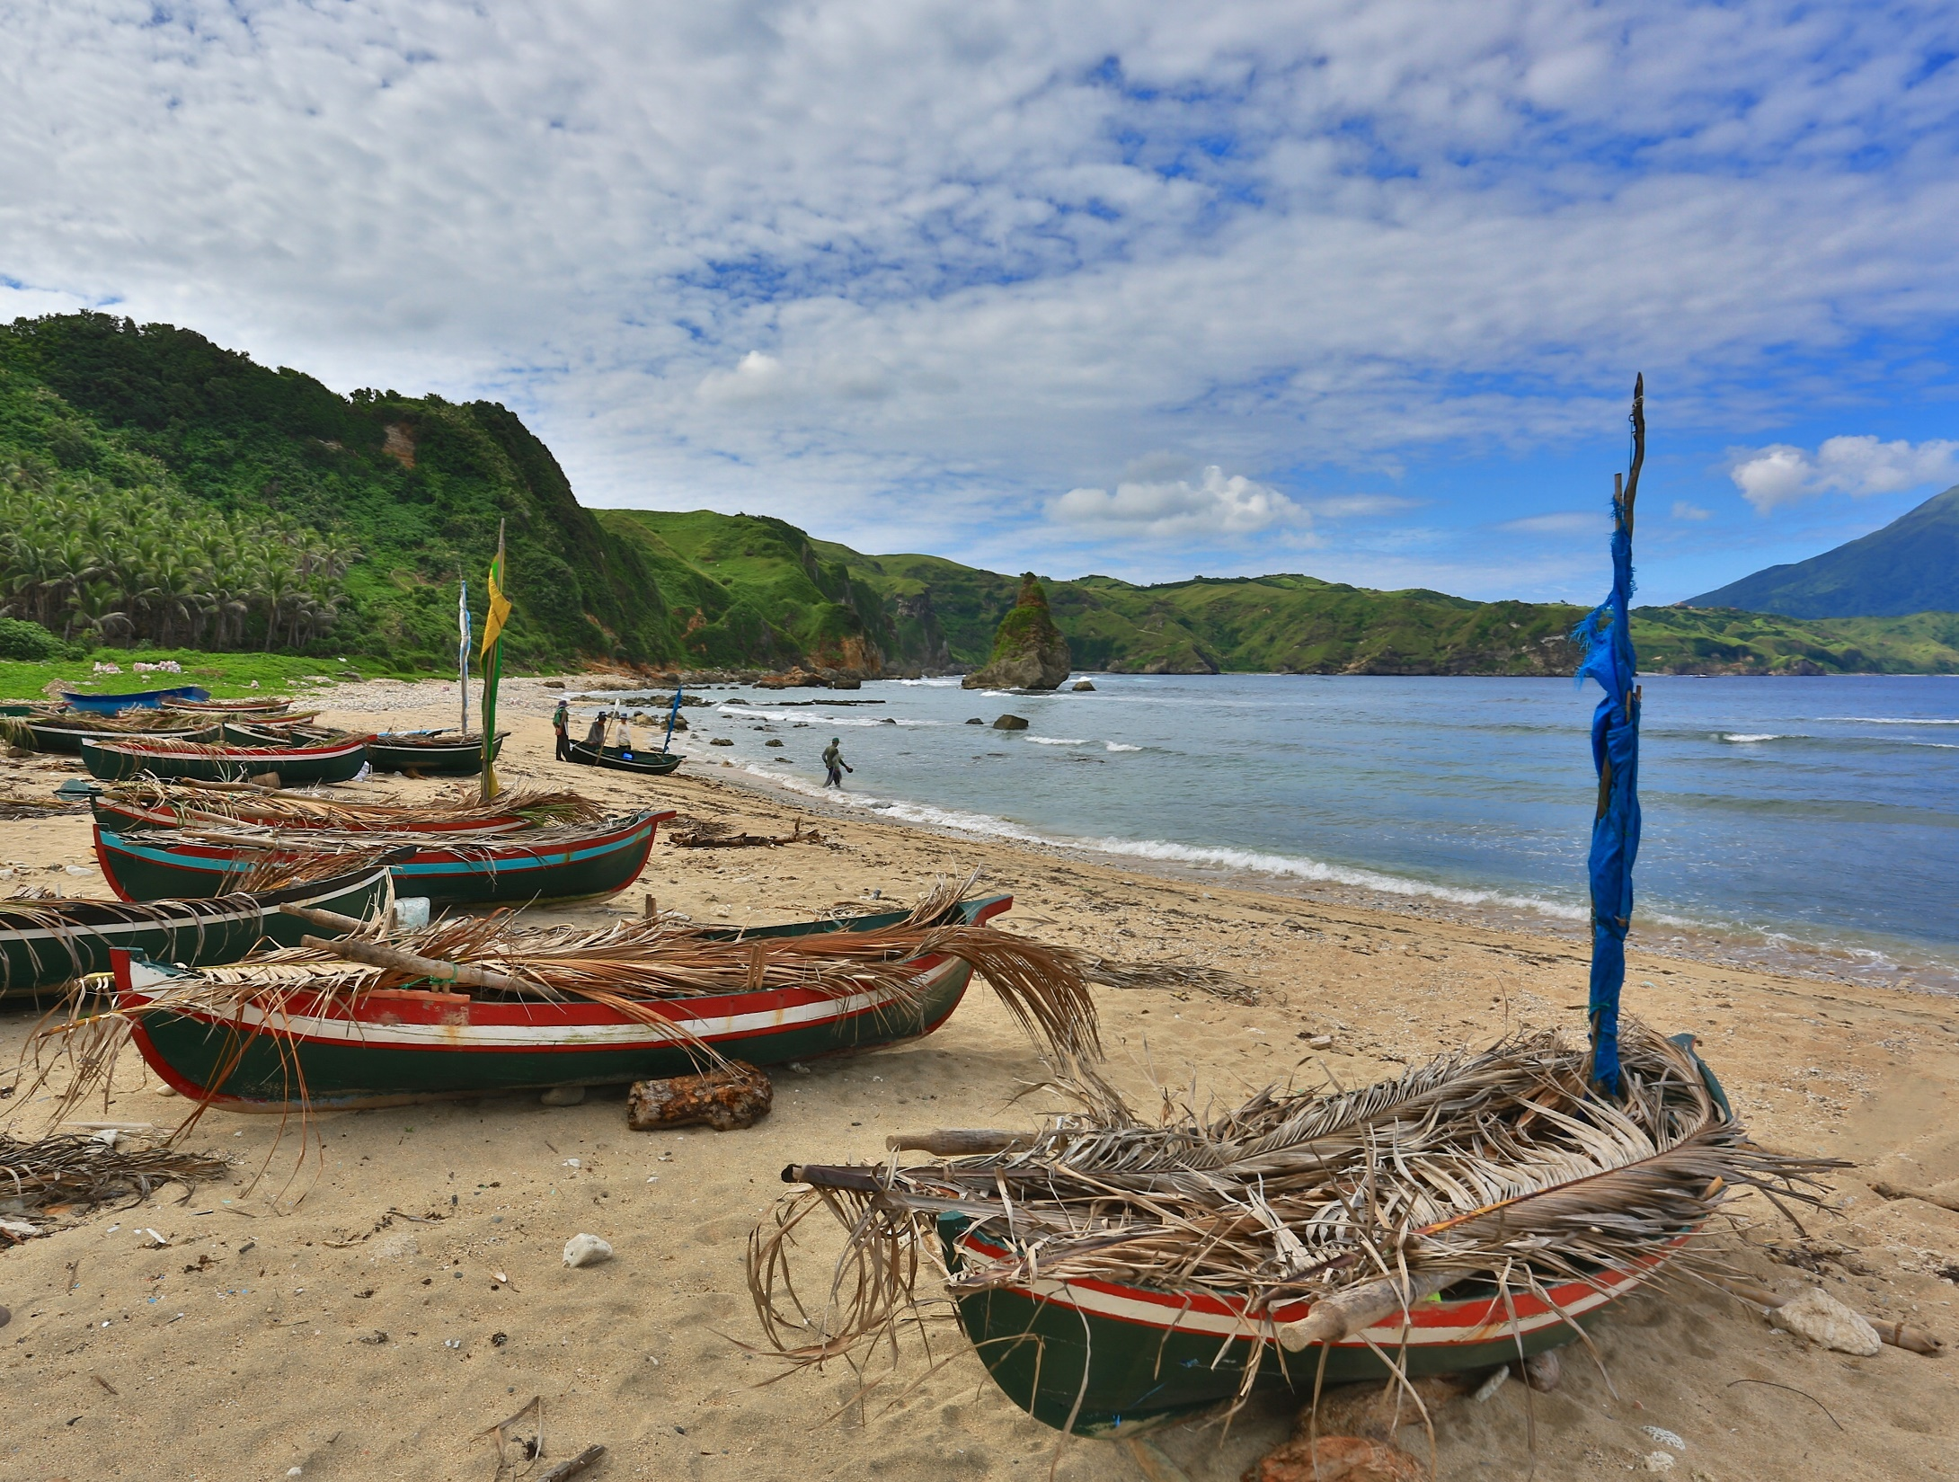

Slide 48

Mas parehas silang ugali kaysa DNA nila

Slide 49

Kahit kapatid silang ugali, halos wala silang kontakt tagisa-isa mula noon 1700s kasi international waters na ang paghiwalayin nila

Slide 50


Slide 51


Laji
(Oral Poetry)
Victoria Ballada (Singer)
Lipus minakahel ko ava du kavadinohan Lipus minakahel ko ava du kavantan Ni dawong co du tana Ni da ngay ko ro hanit O madadatiw ka pa do vol dek ni loy ina mo Lalawolovongan ko na imo no pito a vinokeh Do ka ayod ko a michawy oran. | I did not find my loved ones among the Valino vines I did not find my loved ones among the Vangto trees I bow to the ground I look up into the heaven You were still very small inside your mother’s womb I preserve for you this seventy centavos for the future I did it from my heart.

Slide 52

Tao (Irala) indigenous song
https://www.youtube.com/watch?v=b7CFy5Bu2eM

Slide 53
Video: https://youtu.be/rYX6wwtgwFg?t=145
Additional video: https://www.youtube.com/watch?v=kaQRwaw5Fi8

Slide 54
Buod
Idjang
Vakul-Kanayi Festival
Pacita Abad
Food
Tea
Fishing
Laji

Slide 55
Mga Pinagmulan:
Dizon, Eusebio Z. 2000. “Archaeology of Batanes Province, Northern Philippines: The 1996-1997 Status Report.” Bulletin of the Indo-Pacific Prehistory Association 19 (3): 115–24.
Bellwood, Peter., and Eusebio. Dizon. 2013. 4000 Years of Migration and Cultural Exchange: The Archaeology of the Batanes Islands, Northern Philippines. Archaeology.
Veld, Nikie. "The future of the Batanes through the eyes of the Ivatan." Master's thesis, Leiden University, 2014. August 29, 2014. http://hdl.handle.net/1887/32990.

Slide 56
Works Consulted:
https://ivatanlaji.org/about/
http://nlpdl.nlp.gov.ph:81/CC01/NLP00VM052mcd/v1/v25.pdf
http://www.taipeitimes.com/News/feat/archives/2017/02/19/2003665262
http://batanestravelguides.blogspot.com/2012/07/brief-history-of-batanes.html
http://cnnphilippines.com/news/2015/06/16/ph-and-taiwan-coast-guard-standoff-at-itbayat-batanes.html
http://glossaryoffilipinofood.blogspot.com/2015/08/batanes-specialties.html
http://ivatandelicacies.blogspot.com/
http://jibraelangel2blog.blogspot.com/2013/05/william-dampier-voyage-to-batanes.html
http://journeyingjames.com/2011/05/10-food-to-try-when-visiting-batanes/
http://journeyingjames.com/2011/05/2011/05/batanes-chill-time-with-the-ivatans-at-mahatao-lighthouse/
http://journeyingjames.com/2011/05/batanes-chill-time-with-the-ivatans-at-mahatao-lighthouse/
http://junvillegas.blogspot.com/2015/04/itbayat-island-batanes.html
http://lakbaypilipinas.com/travel_philippines/batanes/batanes_history.html
http://lifestyle.inquirer.net/162571/lost-heritage-old-ivatan-houses-going/
http://lifestyle.inquirer.net/261771/sabtang-batanes-undiscovered-shangri-la/
http://lifestyle.inquirer.net/615/%E2%80%98we-were-ivatan-in-an-earlier-life%E2%80%99/
http://liveinthephilippines.com/content/ibatan-or-is-it-ivatan/
http://ncca.gov.ph/subcommissions/subcommission-on-cultural-communities-and-traditional-arts-sccta/northern-cultural-communities/the-batanes-islands/
http://newsinfo.inquirer.net/354967/top-architect-is-ivatan-wants-to-preserve-batanes-heritage
http://nodoors.blogspot.com/2014/06/the-house-of-dakay-in-ivana-batanes.html
http://pages.upd.edu.ph/mariamangahas/publications/modern-bongkog-temporary-weddings-and-dual-samal-and-bisaya-identities
http://photos.ferdzdecena.com/Travel/2015/Batanes/i-2V5smRL/0/L/DSC_2474-L.jpg
http://photos.ferdzdecena.com/Travel/2015/Batanes/i-HWbFsgW/0/L/DSC_2470-L.jpg
http://photos.ferdzdecena.com/Travel/2015/Batanes/i-b5F82gM/0/L/DSC_2509-L.jpg
http://pinas-travel.blogspot.com/2013/08/batanes.html
http://scienceandsocietygroup5.blogspot.com/2014/02/sailing-in-seas-of-batanes-short.html
http://tubagbohol.mikeligalig.com/philippines/batanes/
http://voices.nationalgeographic.com/2014/03/06/the-vanishing-vakul-and-the-changing-indigenous-ivatan-culture/
http://whc.unesco.org/en/tentativelists/521/
http://worldheritage.design.umn.edu/documents/BatanesSummary.pdf
http://www.academia.edu/14452069/The_Batanes_Nephrite_Artefacts
http://www.akrosdayunibers.com/philippines/category/batanes%20itbayatd62d63ebfe
http://www.angkulet.com/2010/10/20/uyugan-batanes-%E2%80%93-places-to-see/
http://www.ann-d-explorer.com/2014/01/batanes.html
http://www.batanes.gov.ph/farming/
http://www.batanes.gov.ph/fishing/
http://www.batanes.gov.ph/history/
http://www.batanes.gov.ph/ivatan-cuisine/
http://www.batanes.gov.ph/music-and-arts/
http://www.jessiekaaa.com/2015/05/how-to-brew-tubho-tea-ivatan-way.html
http://www.pasyalera.com/batanes/basco-batanes/
http://www.pasyalera.com/batanes/batanes-philippines/
http://www.pasyalera.com/batanes/sabtang-island-batanes/
http://www.pasyalera.com/featured/basco-batanes/
http://www.pasyalera.com/wp-content/uploads/2009/04/basco-batanes_16.jpg
http://www.pasyalera.com/wp-content/uploads/2009/04/basco-batanes_18.jpg
http://www.pasyalera.com/wp-content/uploads/2009/04/batanes-resort_12.jpg
http://www.pasyalera.com/wp-content/uploads/2009/05/sabtang-batanes_39.jpg
http://www.pasyalera.com/wp-content/uploads/2009/05/sabtang-batanes_59.jpg
http://www.philstar.com/agriculture/211841/voyavoy-and-ivatans-batanes
http://www.philstar.com/headlines/655400/batanes-bids-unesco-heritage-site-nod
http://www.philstar.com/travel-and-tourism/803788/batanes-gods-shadow-earth
http://www.pinoyadventurista.com/2014/05/batanes-honesty-store-coffee-shop-philippines.html
http://www.pinoyadventurista.com/2014/05/vayang-rolling-hills-in-basco-batanes.html
http://www.rappler.com/life-and-style/travel/ph-travel/131236-sabtang-island-first-vakul-kanayi-festival-batanes
http://www.rappler.com/life-and-style/travel/ph-travel/133790-dorado-mahi-mahi-fishing-kapayvanuvanua-batanes
http://www.rdc2.gov.ph/invest/batanes/index.php/about-batanes/history
http://www.rdc2.gov.ph/invest/batanes/index.php/tourism/must-know
http://www.senyorita.net/2014/10/exploring-sabtang-island-in-batanes-of-music-and-simple-life/
http://www.thepoortraveler.net/2014/06/basco-batanes-tour-resort-rental-budget-guide-philippines/
http://www.thepoortraveler.net/2014/06/ivatan-culture-language-food-batanes-philippines/
http://www.thepoortraveler.net/wp-content/uploads/2014/03/North-Batan-Tour-Batanes.jpg
http://www.traveling-up.com/travel-guide-itbayat-batanes/
http://www.traveltrilogy.com/2016/11/itbayat-island-batanes.html
http://www.traveltrilogy.com/2017/02/batanes-south-batan-island-attractions.html
http://www.wanderlass.com/wow-philippines/batanes.html
https://banebanerbanest.wordpress.com/2014/09/03/15-must-visit-spots-in-batanes/
https://batanestravelguides.blogspot.com/2012/07/brief-history-of-batanes.html
https://bmcgenet.biomedcentral.com/articles/10.1186/1471-2156-12-21
https://commons.wikimedia.org/wiki/File:Oldest_House_in_Ivatan.jpg#filelinks
https://en.wikipedia.org/wiki/Basco,_Batanes
https://en.wikipedia.org/wiki/Batanes
https://en.wikipedia.org/wiki/Batanes_castles
https://en.wikipedia.org/wiki/Idjang
https://en.wikipedia.org/wiki/Ivatan_language
https://en.wikipedia.org/wiki/Ivatan_people
https://en.wikipedia.org/wiki/Basco,_Batanes
https://en.wikipedia.org/wiki/Basco_Lighthouse#/media/File:Lighthouse,_Batanes_Island,_Philippines.JPG
https://en.wikipedia.org/wiki/Batanes
https://en.wikipedia.org/wiki/Batanes#History
https://en.wikipedia.org/wiki/Batanes:_Sa_Dulo_Ng_Walang_Hanggan
https://en.wikipedia.org/wiki/File:Basco_Batanes_Lighthouse.png
https://en.wikipedia.org/wiki/Idjang
https://en.wikipedia.org/wiki/Itbayat,_Batanes

Slide 57
Works Consulted (cont.)
http://ichcap.org/eng/ek/sub3/pdf_file/domain5/092_Traditional_Boats_in_Batanes.pdf
http://iloko.tripod.com/Ivatan.htm
http://intrepidwanderer.com/2014/02/finding-the-rakuh-a-idi-spring-fountain-of-youth-in-uyugan-batanes/
http://ivatanassociationinc.weebly.com/cd-launching-souvenir-program.html
http://ivatanassociationinc.weebly.com/music-of-batanes-cd-launching.html
http://www.global-nomad.com/batanes_content/batanes_accomodations.html
http://www.global-nomad.com/batanes_content/batanes_activities.html
http://www.global-nomad.com/batanes_content/batanes_culture.html
http://www.global-nomad.com/batanes_content/batanes_history.html
http://www.gmanetwork.com/news/lifestyle/travel/227681/a-day-on-sabtang-island-in-batanes/story/
http://www.gmanetwork.com/news/news/regions/322978/batanes-fisherman-found-alive-in-japan-after-drifting-at-sea-for-days/story/
http://www.gmanetwork.com/news/story/227681/lifestyle/travel/a-day-on-sabtang-island-in-batanes
http://www.gmanetwork.com/news/story/227681/lifestyle/travel/a-day-on-sabtang-island-in-batanes/
http://www.ironwulf.net/2015/08/24/batanes-savidug-idjang-exploring-the-ancient-dwellings-of-the-ivatans
http://www.ironwulf.net/2015/08/24/batanes-savidug-idjang-exploring-the-ancient-dwellings-of-the-ivatans/
http://www.ironwulf.net/2015/08/24/batanes-savidug-idjang-exploring-the-ancient-dwellings-of-the-ivatans/2/
http://www.ivanhenares.com/2010/03/batanes-batanes-food-adventure.html
http://www.batanes.gov.ph/rituals-and-practices/
http://www.batanes.gov.ph/traditional-games/
http://www.batanes.gov.ph/traditional-handicrafts/
http://www.batanes.gov.ph/traditional-ivan-shelter/
http://www.batanes.gov.ph/wp-content/uploads/Fishing.docx
http://www.batanes.gov.ph/wp-content/uploads/fishing4.jpg
http://www.batanes.gov.ph/wp-content/uploads/games2.jpg
http://www.batanes.gov.ph/wp-content/uploads/handi.jpg
http://www.earth.sinica.edu.tw/~epma/papers/Published%20PDF%20files/Archaeology%202004-2013/A20%20Hung-Iizuka%20Batanes%20Nephrite%20TA40%202013.pdf
http://www.elib.gov.ph/results.php?f=subject&q=Excavation+(Archaeology)+--+Recuaydi+nakavajayan%2C+Batanes+(Philippines)
http://www.filipiknow.net/batanes-facts-and-trivia/
http://www.filipiknow.net/wp-content/uploads/2014/08/Batanes-Castle-or-Savidug-Ijang.png
http://www.fundacionpacita.ph/
http://www.fundacionpacita.ph/gallery/
https://en.wikipedia.org/wiki/Ivana,_Batanes
https://en.wikipedia.org/wiki/Ivana_(Batanes)
https://en.wikipedia.org/wiki/Ivatan_people
https://en.wikipedia.org/wiki/List_of_barangays_in_Batanes
https://en.wikipedia.org/wiki/Mahatao,_Batanes
https://en.wikipedia.org/wiki/Sabtang,_Batanes
https://en.wikipedia.org/wiki/Uyugan,_Batanes
https://es.wikipedia.org/wiki/Batanes
https://es.wikipedia.org/wiki/Batanes#/media/File:Ph_cagayan_valley.png
https://es.wikipedia.org/wiki/Batanes#/media/File:Ruins_at_Sitio_Songsong.png
https://es.wikipedia.org/wiki/Ivana_(Batanes)
https://glossaryoffilipinofood.blogspot.com/2015/08/batanes-specialties.html
https://ivatandelicacies.blogspot.com/
https://jibraelangel2blog.blogspot.com/2013/05/william-dampier-voyage-to-batanes.html
https://junvillegas.blogspot.com/2015/04/itbayat-island-batanes.html
https://liquiddruid.wordpress.com/2009/12/21/batanes-day-1/#more-71
https://liquiddruid.wordpress.com/2009/12/22/batanes-day-2-arriving-at-sabtang-part-1/
https://liquiddruid.wordpress.com/2009/12/22/batanes-day-2-touring-sabtang-part-2/
https://liquiddruid.wordpress.com/2009/12/30/batanes-day-2-touring-sabtang-part-3/
https://liquiddruid.wordpress.com/2010/01/15/batanes-day-3-back-to-batan-part-1/
https://liquiddruid.wordpress.com/2010/02/01/batanes-day-4-biking-from-ivana-to-mahatao-to-basco/
https://liquiddruid.wordpress.com/2010/02/08/batanes-travel-tips/
https://liquiddruid.wordpress.com/2011/09/18/return-to-batanes-a-prologue/
https://liquiddruid.wordpress.com/2011/10/15/in-search-of-batanes-prehispanic-past/
https://liquiddruid.wordpress.com/2013/03/04/batanes-is-not-anyones-private-playground/#more-4415
https://monicasees.wordpress.com/tag/ivatan/
https://nodoors.blogspot.com/2014/06/the-house-of-dakay-in-ivana-batanes.html
https://pamobieta.wordpress.com/2009/06/03/the-food-of-batanes-a-batanes-food-trip-part-2/
https://pinas-travel.blogspot.com/2013/08/batanes.html
https://psa.gov.ph/content/population-batanes-showed-upward-swing
https://ronamontilla.wordpress.com/2017/03/10/unra%EF%BB%BFveling-the-beauty-within-ivatans-culture/
https://scienceandsocietygroup5.blogspot.com/2014/02/sailing-in-seas-of-batanes-short.html
https://search.lib.byu.edu/byu/search?q=Ivatan
https://themetaphoriclife.files.wordpress.com/2015/05/dsc_7807.jpg
https://themixedculture.com/2013/10/15/batanes-philippines/
https://trekeffect.com/travel-blog/surreal-beauty-batanes-scotland-east
https://twitter.com/iomediavideos/status/550804636580323328
https://twitter.com/vbyssey/status/800855801266982912
https://web.archive.org/web/20080311204203/http://www.ncip.gov.ph/resources/ethno_detail.php?ethnoid=60
https://wolverina.wordpress.com/2008/05/05/batanes-overload/
https://www.academia.edu/14452069/2013_The_Batanes_Nephrite_Artefacts
https://www.academia.edu/14452069/The_Batanes_Nephrite_Artefacts
https://www.flickr.com/photos/cricru/5887319230
https://www.jstor.org/stable/29792498
https://www.travelblog.org/Asia/Philippines/blog-162058.html
https://www.vigattintourism.com/tourism/articles/Ijangs-Mountain-Fortresses-of-Batanes
https://www.wanderlass.com/wow-philippines/batanes.html
https://www.youtube.com/results?search_query=ivatan+folk+songs
https://www.youtube.com/watch?v=2G_mI61EN34
https://www.youtube.com/watch?v=59QhUutYYjI
https://www.youtube.com/watch?v=7BoShVoIzCs
https://www.youtube.com/watch?v=STHqQK2gHsc
https://www.youtube.com/watch?v=UCK6tnN0B-k
https://www.youtube.com/watch?v=We_6XMM4xro
https://www.youtube.com/watch?v=_IbNuMOMH-A
https://www.youtube.com/watch?v=dadhbV2Es0Y
https://www.youtube.com/watch?v=td-VSN4iqe4
https://www.youtube.com/watch?v=vrWdIAxvytA
http://ecai.org/batanesatlas/BatanesVideos.html

Slide 58
Ang mga kawiliwili pa
In 1687, a crew of English freebooters headed by William Dampier came with a Dutch crew and named the islands in honor of their country's monarchs. Itbayat was named "Orange Isle" in honor of William of Orange, and Batan was named "Grafton Isle" after Henry FitzRoy, 1st Duke of Grafton. Sabtang Isle was named "Monmouth Isle" after the James Scott, 1st Duke of Monmouth. Capt. Dampier stayed for less than three months, and did not claim the islands for the British crown.
These people make but small low houses. The sides, which are made of small posts wattled with boughs, are not above 4 foot and a half high: the ridge-pole is about 7 or 8 foot high. They have a fireplace at one end of their houses and boards placed on the ground to lie on. They inhabit together in small villages built on the sides and tops of rocky hills, 3 or 4 rows of houses, one above another and on such steep precipices that they go up to the first row with a wooden ladder, and so with a ladder still from every storey up to that above it, there being no way to ascend. The plain on the first precipice may be so wide as to have room both for a row of houses that stand all along on the edge or brink of it, and a very narrow street running along before their doors, between the row of houses and the foot of the next precipice; the plain of which is in a manner level to the tops of the houses below, and so for the rest. The common ladder to each row or street comes up at a narrow passage left purposely about the middle of it; and the street, being bounded with a precipice also at each end, it is but drawing up the ladder if they be assaulted, and then there is no coming at them from below, but by climbing up against a perpendicular wall: and, that they may not be assaulted from above, they take care to build on the side of such a hill whose back side hangs over the sea, or is some high, steep, perpendicular precipice, altogether inaccessible. These precipices are natural; for the rocks seem too hard to work on; nor is there any sign that art has been employed about them. On Bashee island there is one such, and built upon, with its back next the sea. Grafton and Monmouth isles are very thick set with these hills and towns; and the natives, whether for fear of pirates, or foreign enemies, or factions among their own clans, care not for building but in these fastnesses; which I take to be the reason that Orange Isle, though the largest, and as fertile as any, yet being level and exposed has no inhabitants. I never saw the like precipices and towns.
These people are pretty ingenious also in building boats. Their small boats are much like our deal yawls but not so big; and they are built with very narrow plank pinned with wooden pins and some nails. They have also some pretty large boats which will carry 40 or 50 men. These they row with 12 or 14 oars of a side. They are built much like the small ones and they row doubled-banked; that is, two men setting on one bench, but one rowing on one side, the other on the other side of the boat. They understand the use of iron and work it themselves. Their bellows are like those at Mindanao. The common employment for the men is fishing; but I did never see them catch much: whether it is more plenty at other times of the year I know not. The women do manage their plantations.
They had another dish made of a sort of locusts, whose bodies were about an inch and a half long and as thick as the top of one's little finger; with large thin wings and long and small legs. At this time of the year these creatures came in great swarms to devour their potato leaves and other herbs; and the natives would go out with small nets and take a quart at one sweep. When they had enough they would carry them home and parch them over the fire in an earthen pan; and then their wings and legs would fall off and their heads and backs would turn red like boiled shrimps, being before brownish. Their bodies being full would eat very moist, their heads would crackle in one's teeth. I did once eat of this dish and liked it well enough; but their other dish my stomach would not take.
I could never perceive them to worship anything, neither had they any idols; neither did they seem to observe any one day more than other. I could never perceive that one man was of greater power than another; but they seemed to be all equal; only every man ruling in his own house, and the children respecting and honouring their parents. Yet it is probable that they have some law or custom by which they are governed; for while we lay here we saw a young man buried alive in the earth; and it was for theft as far as we could understand from them. There was a great deep hole dug and abundance of people came to the place to take their last farewell of him: among the rest there was one woman who made great lamentation and took off the condemned person's earrings. We supposed her to be his mother. After he had taken his leave of her and some others he was put into the pit and covered over with earth. He did not struggle but yielded very quietly to his punishment; and they rammed the earth close upon him and stifled him.
From the writings of William Dampier

